Slide 1

MRSA INFECTIONS -Current status and Future scenario
Dr Rahul S Kamble,
MBBS, MD Microbiology
Diploma Infectious Diseases (UNSW, Australia)
Infection Control course (Harvard Medical School, USA)
International Clinical Tropical Medicine course
(CMC Vellore|Haukeland university|McGill university)
International Vaccinology course (CMC Vellore)
Six Sigma Black Belt (Govt of India certified)
Auditor: JCI|NABH|NABL|CSSD|RBNQA|Texila university
PGDBA|PGDHM|PGDCR|PGDMR|PGDOM|
PGDMLS|PGDIM|PGDHI|PGDBI|PGDHA|CCDHHO
Consultant Clinical Microbiologist & Infectious Diseases
Project Lead - Antimicrobial Stewardship at Americares India Foundation

Slide 2
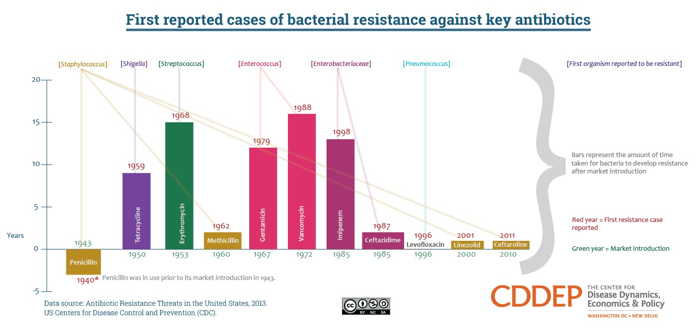
Timeline of Antibiotic Introduction & Resistance

Slide 3
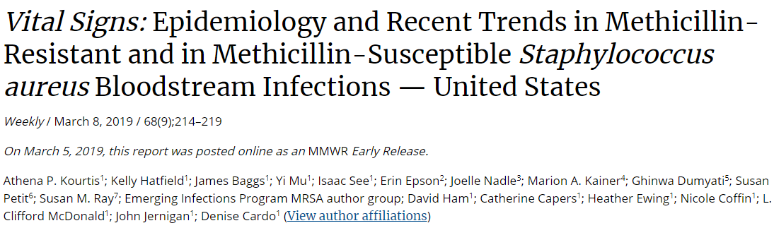
CDC Report
What is added by this report?
Nearly 120,000 Staphylococcus aureus bloodstream infections and 20,000 associated deaths occurred in the United States in 2017.
After years of progress, the rate of decline of MRSA bloodstream infections has slowed, whereas bloodstream infections caused by methicillin-susceptible S. aureus are increasing slightly in the community (3.9% annually, 2012–2017).
What are the implications for public health practice?
Adherence to CDC recommendations for preventing device- and procedure-associated infections and interrupting transmission, along with innovative, tailored interventions (including decolonization) are needed to further prevent S. aureus infections.

Slide 4
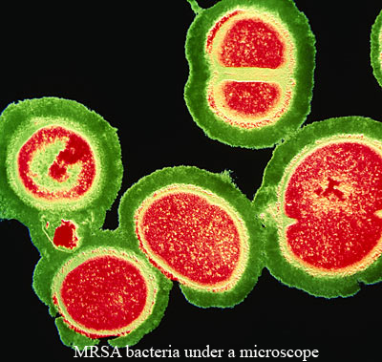
Methicillin/Meticillin Resistant Staphylococcus aureus (MRSA)
Is a gram positive cocci that is resistant to beta lactam group of antibiotics
  Penicillins
  Cephalosporins(except 5th generation cephalosporins)
  Carbapenems
  MRSA causes a variety of disseminated, lethal infections
These bacteria colonize the skin in approximately 40% of healthy people.
Frequently S aureus is cultured from nasal passages in approximately 30% of the healthy population
The evolution of the increasing microbial resistance is multifactorial, but the chronic overuse of antibiotics geographically has imposed selective pressures on many pathogens including S aureus. These selective pressures mediate the acquisition of resistance
Notes:
In the early 1970’s physicians were very confident about treating bacterial infections. But ,their confidence was shaken by the emergence of resistance to multiple antibiotics by Staphylococcus aureus. MRSA stands for Methicillin Resistant Staphylococcus aureus (S aureus). These bacteria colonize the skin in approximately 40% of healthy people. Frequently S aureus is cultured from nasal passages in approximately 30% of the healthy population. The evolution of the increasing microbial resistance is multifactorial, but the chronic overuse of antibiotics geographically has imposed selective pressures on many pathogens including S aureus. These selective pressures mediate the acquisition of resistance and foreign DNA

Slide 5
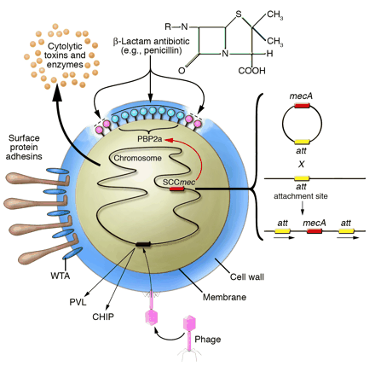
MECHANISM OF RESISTANCE
http://www.jci.org/cgi/content/full/114/12/1693/F1
Notes:
This schematic diagram from Journal of clinical investigation illustrates the mechanism of resistance in MRSA. Methicillin resistance requires the presence of the chromosomally localized mecA gene. The mec A gene is the gene responsible for methicillin resistance and is part of a mobile genetic element found in many MRSA strains called SCCmec. To date, There are at least five different SCCmec elements. These elements integrate at the same time site in the chromosome by a mechanism involving site-specific recombination and excision from the chromosome at attBscc, that is a part of an open reading frame of unknown function near the origin of replication. The genetic mechanism responsible for the transfer of these mobile elements are uncertain. However, what we do know is that mecA gene in MRSA is responsible for the synthesis of penicillin binding protein2A. The MecA gene expression alters PBP2A in S aureus resulting in a loss of target affinity. The mecA gene encodes a new b-lactam-insensitive to penicillin[5]

Slide 6
MecC gene is a homolog of mecA.
It was initially designated mecALGA251.
It shares 69% nucleotide homology with mecA.
The mecA PCR or PBP2a latex agglutination test fails to detect mecC.
In sensitivity testing, using both cefoxitin and oxacillin, mecA-MRSA show resistance to both antibiotics whereas the majority of mecC MRSA will express resistance only to cefoxitin.
This discrepancy is explained by the observation that PBP2a produced by mecC strains have higher affinity to oxacillin than cefoxitin.

Slide 7
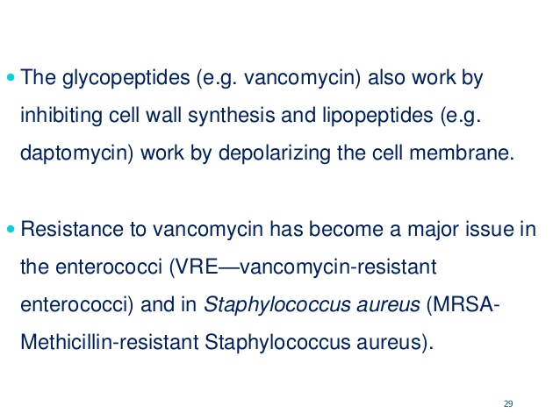
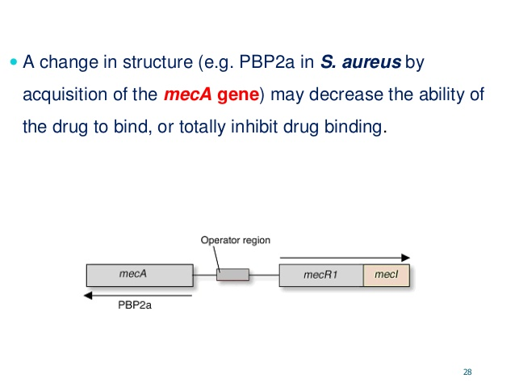
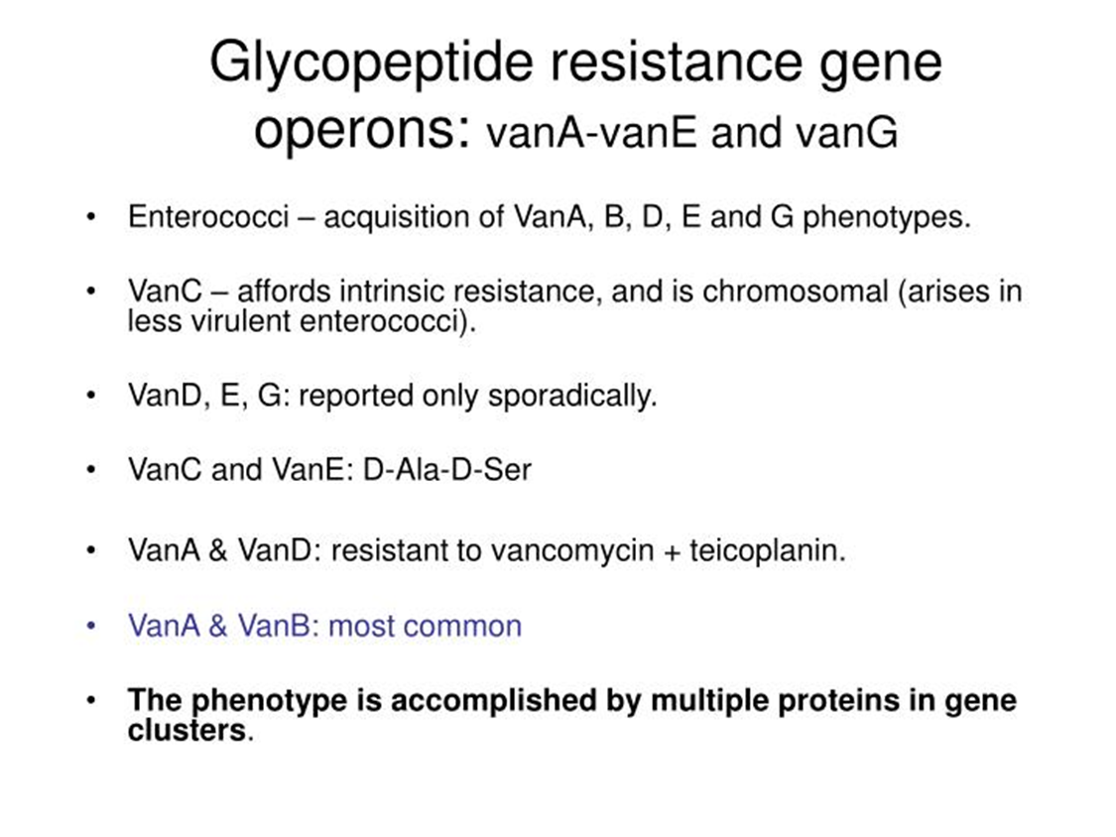
RESISTANCE MECHANISMS

Slide 8
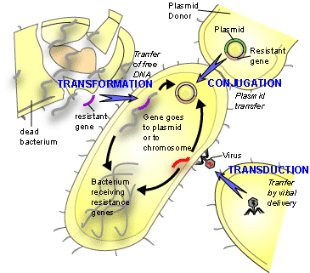
GENE TRANSFER FOR RESISTANCE
http://www.bioteach.ubc.ca/Biodiversity/AttackOfTheSuperbugs
Notes:
The development and acquisition of resistance in MRSA also requires the presence of other mechanisms. Horizontal gene transfer is a mechanism by which plasmids (resistant genes contained in small packets) found inside the cytoplasm of the bacteria have the ability to transfer resistance genes between the same and different species. The three different mechanisms involved in resistance are: 1) Conjugation is where there is cell-to-cell contact, in other words, this is bacterial sex. Some scientists speculate that this is the main mechanism by which resistant gene transfer occurs. 2) Transformation is where bacteria from the external environment is acquired. 3) Transduction involves bacteriophages transfering DNA between two closely related bacteria[4]. Now that we understand some of the mechanisms involved with MRSA acquiring antibiotic resistance, I would like to turn some attention to the many intrinsic virulence factors of S. aureus

Slide 9
MRSA Introduction
MRSA is a type of staph bacteria that is resistant to certain antibiotics called beta-lactams (e.g., penicillins, carbapenems)
Recognizing the signs and receiving treatment in early stages reduces the chances of the infection becoming severe
More severe and potentially life-threatening MRSA infections occur in the hospital setting
  Bloodstream infections
  Surgical site infections
  Pneumonia

Slide 10
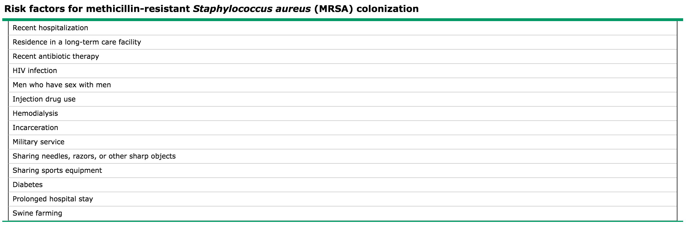
MRSA Risk Factors

Slide 11
MRSA Introduction
3 Strains of MRSA
  Community- originated MRSA (CA-MRSA)
  Nosocomial or Healthcare Associated MRSA (HA-MRSA)
  Livestock-associated MRSA (LA-MRSA) - a new type of MRSA that arose from animals has recently been described

Slide 12
HA – MRSA Definition
Obtained >2 days into hospital stay
Often resistant to a greater number of antibiotics (aminoglycosides, macrolides, fluoroquinolones)
Responsible for great percentage of invasive disease; ~85% nationwide
Klevens, RM et al. JAMA. 2007;298(15):1763-1771; Diep et al Lancet 2006; Han et al J Clin Micro 2007.

Slide 13
HA – MRSA Infections caused
Infections caused by HA-MRSA include
bloodstream infections
urinary tract infections
respiratory tract infections
surgical-wounds
device-associated infections
S.S. Boswihi, E.E. Udo / Current Medicine Research and Practice 8 (2018) 18–24

Slide 14
HA – MRSA Risk factors
Risk factors for acquiring HA - MRSA include
Previous admission to healthcare facilities,
Impaired immune system,
Use of multiple antibiotics,
Use of invasive medical devices and
Old age
S.S. Boswihi, E.E. Udo / Current Medicine Research and Practice 8 (2018) 18–24

Slide 15
HA – MRSA Genetics of resistance
Genetically, the HA-MRSA carried SCC mec types I, II and III, are usually multiresistant to antibiotics, and tend to multiply slowly in culture
S.S. Boswihi, E.E. Udo / Current Medicine Research and Practice 8 (2018) 18–24

Slide 16
CA – MRSA Definition
No history of recent hospitalization, medical procedure, or indwelling device
Typically skin and soft tissue infections (SSTIs)
  ~14% nationwide
  Athletes, prisoners, military recruits
  Military deployments
Harder to tell CA and HA apart now
  Clusters of isolates with multiple resistance to erythromycin, clindamycin, tetracycline, ciprofloxacin, and mupirocin
Klevens, RM et al. JAMA. 2007;298(15):1763-1771; Diep et al Lancet 2006; Han et al J Clin Micro 2007.

Slide 17
CA – MRSA Infections caused
Mostly associated with Skin and soft tissue infections
  Impetigo, cellulitis, folliculitis, boils
Some CA-MRSA strains have been reported to cause severe infections
  Necrotizing fasciitis
  post-influenza pneumonia
  septic thrombophlebitis
  septic arthritis
  bacteremia
S.S. Boswihi, E.E. Udo / Current Medicine Research and Practice 8 (2018) 18–24

Slide 18
CA – MRSA Genetics of resistance
Usually susceptible to non-beta lactam antibiotics carry smaller-sized SCCmec types IV, V and VI.
In addition, CA-MRSA strains often express lower levels of resistance to oxacillin (MIC; 8–32 mg/L)
Multiply faster than HA-MRSA strains with significantly shorter doubling times
  May help CA-MRSA achieve successful colonization by enabling it to out compete commensal bacterial flora
S.S. Boswihi, E.E. Udo / Current Medicine Research and Practice 8 (2018) 18–24

Slide 19
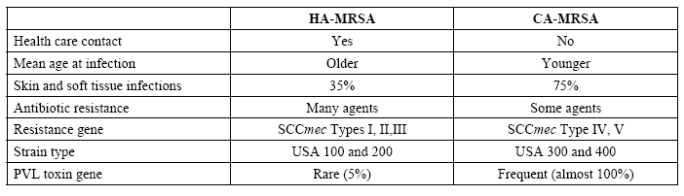
HA – MRSA CA - MRSA

Slide 20
HA – MRSA CA - MRSA
Most Invasive MRSA Infections Are Healthcare-Associated
Klevens et al JAMA 2007;298:1763-71

Slide 21
LA – MRSA Definition
Staph. aureusis is also an important cause of infections in live stock resulting in economic losses in the food industry
LA-MRSA strains were initially identifiedand further molecular typing revealed a new lineage of MRSA that belonged to clonal complex 398 (CC398).
Appeared in human patients in contact with infected or colonized animals.
Other LA-MRSA lineages reported in humans include ST9, ST97 and ST433.
S.S. Boswihi, E.E. Udo / Current Medicine Research and Practice 8 (2018) 18–24

Slide 22
LA – MRSA Infections caused
LA-MRSA has also caused invasive infections in humans including
  endocarditis
  osteomyelitis
  ventilator-associated pneumonia
S.S. Boswihi, E.E. Udo / Current Medicine Research and Practice 8 (2018) 18–24

Slide 23
Global distribution Epidemic MRSA clones
S.S. Boswihi, E.E. Udo / Current Medicine Research and Practice 8 (2018) 18–24

Slide 24
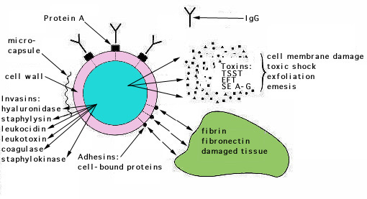
VIRULENCE DETERMINANTS
http://textbookofbacteriology.net/staph.html
Notes:
Figure taken from Textbook of Bacteriology. MRSA expresses many potential virulence factors: (1) surface proteins that promote colonization of host tissues; (2) invasins that promote bacterial spread in tissues (leukocidin, kinases, hyaluronidase); (3) surface factors that inhibit phagocytic engulfment (capsule, Protein A); (4) biochemical properties that enhance their survival in phagocytes (carotenoids, catalase production); (5) immunological disguises (Protein A, coagulase, clotting factor); and (6) membrane-damaging toxins that lyse cell membranes (hemolysins, leukotoxin, leukocidin; (7) exotoxins that damage host tissues or otherwise provoke symptoms of disease (SEA-G, TSST, ET (8) inherent and acquired resistance to antimicrobial agents[2].

Slide 25
Panton Valentine-leucocidin (PVL)
A synergohymenotropic toxin
Combination of two proteins that act synergistically (Luk S and F)
Potent mediator of inflammation and activator of leucocytes
PVL then destroys leucocytes by creating lytic pores
    With community-associated MRSA, if you have a colonizing strain, about a fourth of them produce PVL toxin; if you have an infection, over three fourths of them produce this PVL toxin
Associated with necrotic infections:
    Skin
    Subcutaneous tissues
    Pneumoniae (In the lung, especially, PVL toxin is associated with an increased mortality rate in these patients who develop a necrotizing pneumonia, with a mortality rate of about 30% with PVL positive strains)
The toxin is encoded by bacteriophages which explains its carriage in strains belonging to diverse genetic backgrounds.
Current Medicine Research and Practice 8 (2018) 18–24

Slide 26
Arginine catabolic mobile element (ACME)
Novel class of virulence determinants carried on a genomic island which varies in size from 31-kb to 46-kb in staphylococcus.
ACME encodes a putative virulence determinant which provides for several immune modulating functions, including resistance to polyamines which serve as a non-specific immune response both on intact skin, and following the inflammatory response in wound healing.
ACME is thought to aid bacterial growth, provide a competitive survival advantage, and enhance the fitness of S. aureus possibly by facilitating colonization and/or hematogenous spread to target organs
Current Medicine Research and Practice 8 (2018) 18–24

Slide 27
MRSA Epidemiology
Worldwide, an estimated two billion people carry some form of S. aureus; of these, up to 53 million (2.7% of carriers) are thought to carry MRSA.
In the U.S., 95 million carry S. aureus in their noses; of these, two and a half million (2.6% of carriers) carry MRSA (Graham, Lin, & Larson, 2006).

Slide 28
HA – MRSA Worldwide prevalence
S. Stefani et al. / International Journal of Antimicrobial Agents 39 (2012) 273– 282

Slide 29
MRSA Occurrence in India
Gradual increase in the number of reports over the years
The MRSA carriage rate among Health care workers in hospitals reported to be 10 to 14.3%
The isolation rates for MRSA from outpatients, ward inpatients and intensive care units (ICUs) were 27%, 49% and 47%, respectively, in 2009.
  The majority of S. aureus isolates were obtained from patients with SSTIs, followed by those suffering from bloodstream infections and respiratory infections
Incidence of HA-MRSA was as low as 6.9% in 1988, but increased to 27%, 32%, 42.5% and 47% in Mumbai, Vellore, Delhi and Bengaluru, respectively, by the late 1990s
https://resistancemap.cddep.org/CountryPage.php?country=India

Slide 30
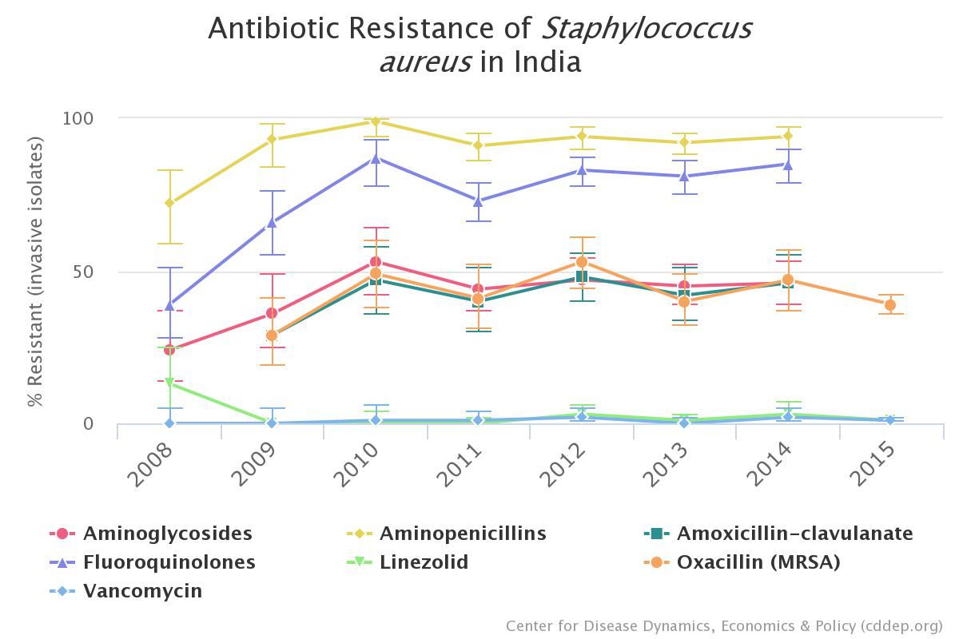
https://resistancemap.cddep.org/CountryPage.php?country=India
Notes:
Data includes aggregated resistance rates for isolates (includes intermediate resistance) from blood and cerebrospinal fluid (i.e., invasive) from inpatients of all ages. Because of differences in scope of collections and testing methods, caution should be exercised in comparing across countries. For more details see methodology.
Country boundaries/designations do not represent CDDEP opinion concerning the legal status of any country, territory, city, or area of its authorities, or concerning the delimitation of its frontiers or boundaries.

Slide 31
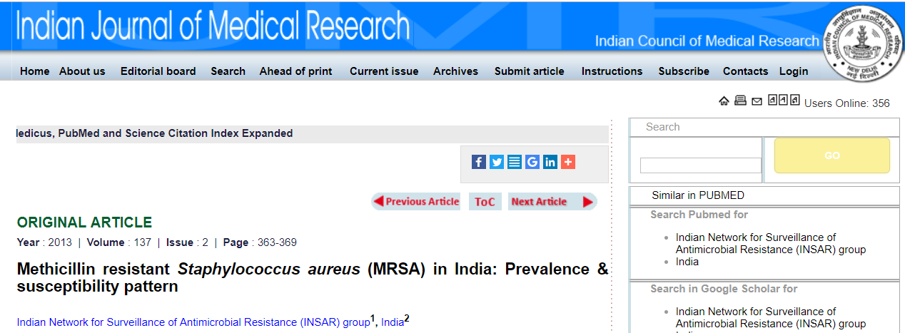
The overall prevalence of MRSA during the study period was 41 %.
Isolation rates for MRSA from OP, ward inpatients and ICU were
  28 %, 42 % and 43 % respectively in 2008
  27 %, 49 % and 47 % respectively in 2009
Indian J Med Res 137, February 2013, pp 363-369

Slide 32
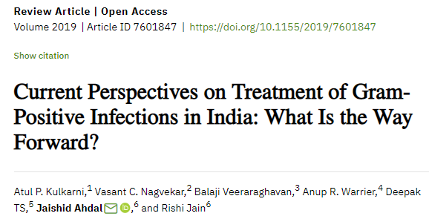
Current perspective
S. aureus isolates, have been reported to increase exponentially from 29% in 2009 to 47% in 2014.
Apart from MRSA, rising prevalence of vancomycin-resistant enterococci (VRE), which ranges from 1 to 9%
Overall mortality rate among patients with multidrug resistant GPIs in India is reported to be 10.8% and in ICU settings, the mortality rate is as high as 16%.

Slide 33
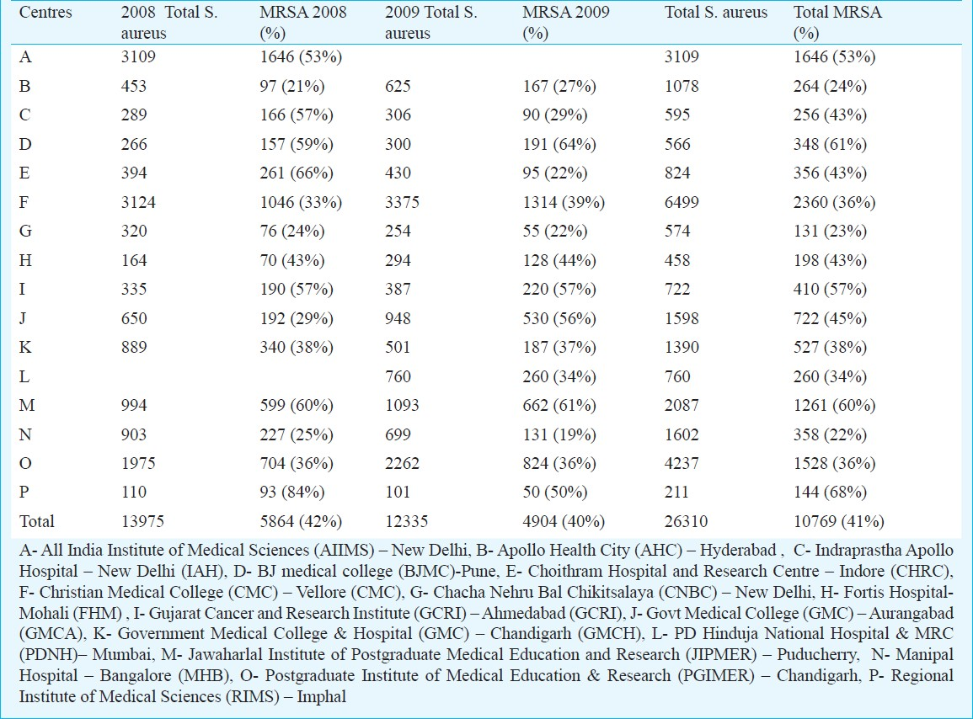
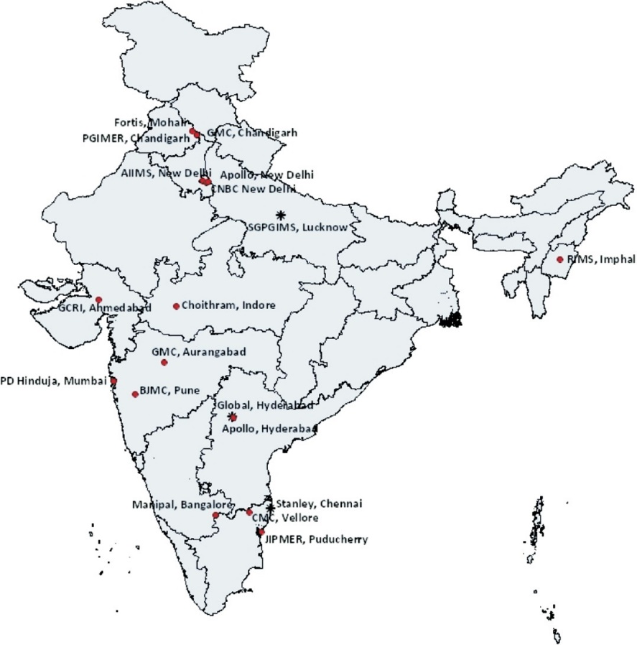
Indian J Med Res 137, February 2013, pp 363-369

Slide 34
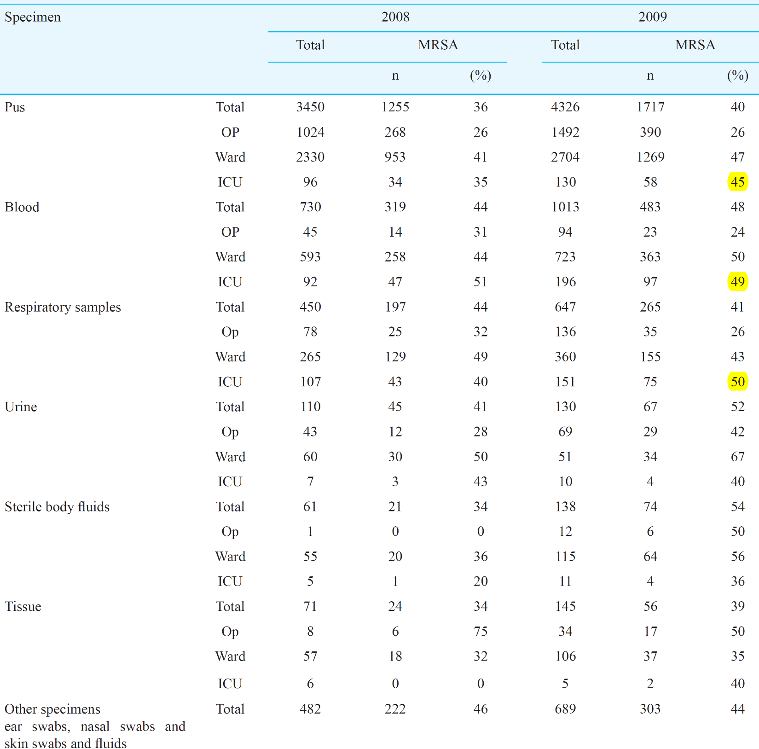
Specimen-wise distribution of
S. aureus and
MRSA
Indian J Med Res 137, February 2013, pp 363-369

Slide 35
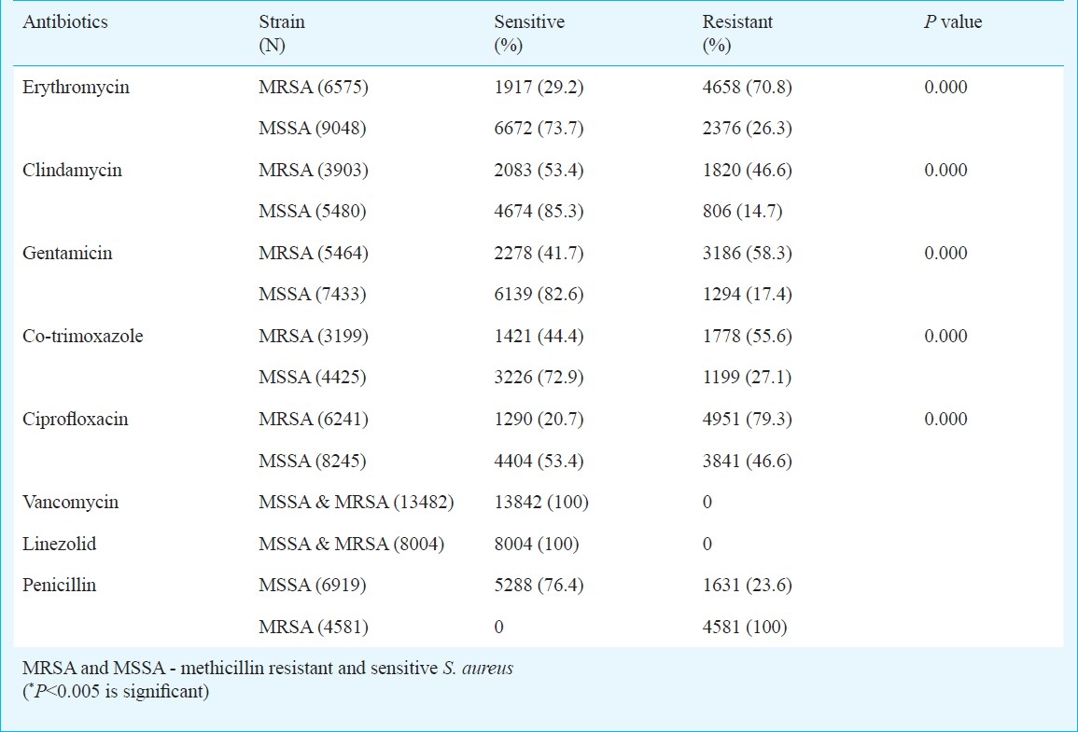
Antibiotic susceptibility of Stap. aureus
Indian J Med Res 137, February 2013, pp 363-369

Slide 36
MRSA India 2013–2015
Distribution of various resistance types of Staphylococcus aureus isolates collected in eastern India, 2013–2015.
  LRSA, linezolid-resistant S. aureus;
  MRSA, methicillin-resistant S. aureus;
  MSSA, methicillin-sensitive S .aureus;
  TRSA, tigecycline-resistant S. aureus;
  VRSA, vancomycin-resistant S. aureus.
The decline in drug effectiveness against S. aureus infections represents a looming threat
Emerging Infectious Diseases • www.cdc.gov/eid • Vol. 22, No. 9, September 2016

Slide 37
MRSA Surveillance Strategies
Passive Surveillance—isolate patients when MRSA is found on clinical culture requests— only identify ~15% of MRSA colonized patients
Targeted Active Surveillance (TAS) + High Risk Surveillance: screen all ICU patients for MRSA, include patients age>90, on dialysis, transplant, or living in long term care—most recommended based on the available evidence
Universal Surveillance: screen everybody—limited evidence; what intervals?
http://www.cdc.gov/ncidod/dhqp/; Salgado CD, Farr BM. Infect Control Hosp Epidemiol 2006; 27:116-121.;

Slide 38
MRSA Testing Methodologies
Broth microdultion testing
Cefoxitin disk screen test
Latex agglutination test for PBP2a
A plate containing 6 μg/ml of oxacillin in Mueller-Hinton agar supplemented with 4% NaCl
Several FDA-approved selective chromogenic agars that can be used for MRSA detection
Polymerase chain reaction (PCR), can be used to detect the mecA gene
  will not detect novel resistance mechanisms such as mecC or uncommon phenotypes such as borderline-resistant oxacillin resistance

Slide 39

MRSA Testing Methodologies
Method | Cost | Hands-On/ Complexity | TAT | Best Choice For…
Conventional Culture (with o/n BE) |  |  |  | Not recommended—there are better methods
Culture w/ Chromagar |  |  |  | Labs with limited staff and resources
GeneOhm |  |  |  | Lab staff with adequate staffing requiring quick TAT
GeneXpert |  |  |  | Labs requiring quick TAT with limited staffing but financial resources

Slide 40
MRSA Testing Methodologies - Time
 | Hands-On Time per Sample | Complexity | TAT
Conventional Culture * | 10 min | low | 3 days
BBL-CHROMAgar * | 5 seconds | low | 2 days
MRSA Select * | 5 seconds | low | 2 days
MRSA-Spectra * | 5 seconds | low | 2 days
BD-GeneOhm | 4.5 min | high | 1 hour
Gene-Xpert | 2 min | moderate | 1 hour
* Includes overnight broth enrichment

Slide 41
Is PCR more sensitive than culture??
Depends on the study
  Overall consensus in literature is YES
  Increase in sensitivity is marginal in many studies
  Highest sensitivities for culture were with broth enrichment (BE) step (60-70% sensitivity without BE)
  Results from our investigations found that BE + CHROMagar had comparable sensitivity to PCR
  Most reported specificities are in the 85-95% range for both methods

Slide 42
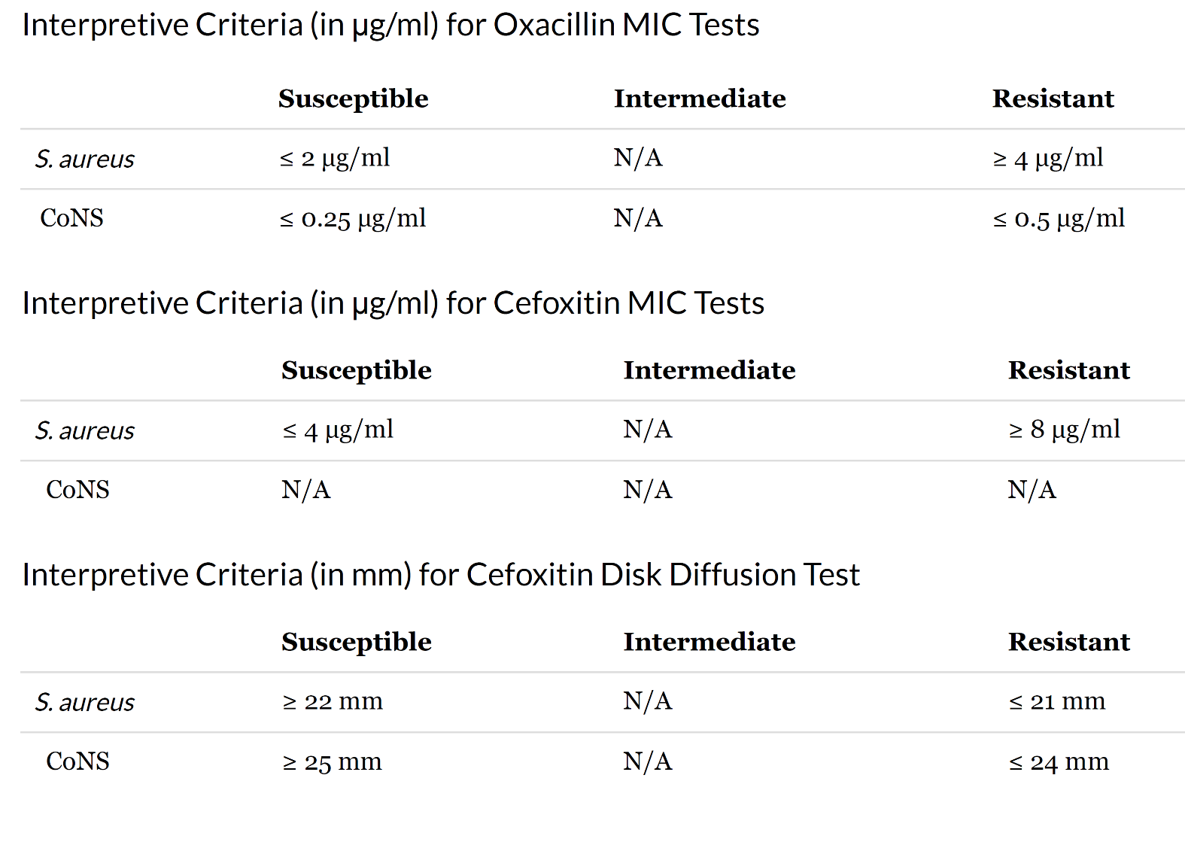
Breakpoints for testing
Susceptibility of staphylococci to oxacillin
https://www.cdc.gov/mrsa/lab/index.html

Slide 43
MRSA
Challenges in diagnosis and typing
Developing resistance to vancomycin, daptomycin and linezolid
Identifying interactions between HA-, CA- and LA- forms of MRSA as they spread to new reservoirs
Monitoring interactions between long-term care facilities and hospital infections
Monitoring the influence of pandemic clones
Identification of mecA variants that are not identified by current SCCmec/mecA PCR typing methods
Identifying markers for hypervirulence, transmissibility and persistence
S. Stefani et al. / International Journal of Antimicrobial Agents 39 (2012) 273– 282

Slide 44
Key consensus decisions
Harmonization of typing methods
S. Stefani et al. / International Journal of Antimicrobial Agents 39 (2012) 273– 282

Slide 45
MRSA Infection Control
The main infection control interventions used against MRSA include
Screening
Hand hygiene
Contact isolation
Cohorting
Decolonization
Routine Standard precautions.
These procedures should be continued till patients become culture-negative for the target multidrug resistant pathogen.
S.S. Boswihi, E.E. Udo / Current Medicine Research and Practice 8 (2018) 18–24

Slide 46
Antibiotic Stewardship
“the optimal selection, dosage, and duration of antimicrobial treatment that results in the best clinical outcome for the treatment or prevention of infection, with minimal toxicity to the patient and minimal impact on subsequent resistance”
S.S. Boswihi, E.E. Udo / Current Medicine Research and Practice 8 (2018) 18–24

Slide 47
Antibiotic Stewardship
The goals of antibiotic stewardship are
To work with health care practitioners to help each patient receive the most appropriate antimicrobial with the correct dose and duration
To prevent antimicrobial overuse, misuse, and abuse and minimize the development of resistance.
To optimize antibiotic use
S.S. Boswihi, E.E. Udo / Current Medicine Research and Practice 8 (2018) 18–24

Slide 48
Screening, isolation and eradication
Vs
Antibiotic stewardship and infection control
Lemmen SW, Lewalter K. Infection. 2018 May

Slide 49
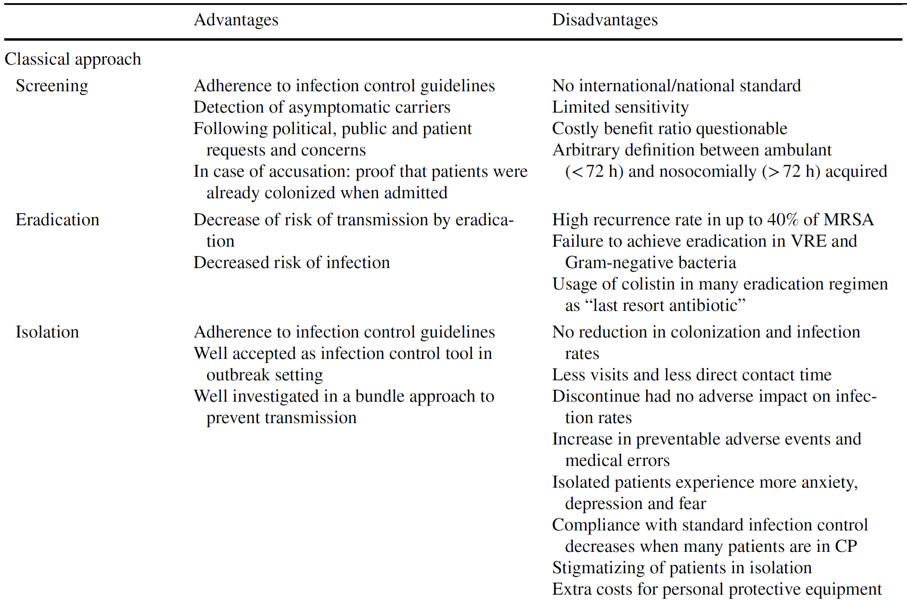
Lemmen SW, Lewalter K. Infection. 2018 May

Slide 50
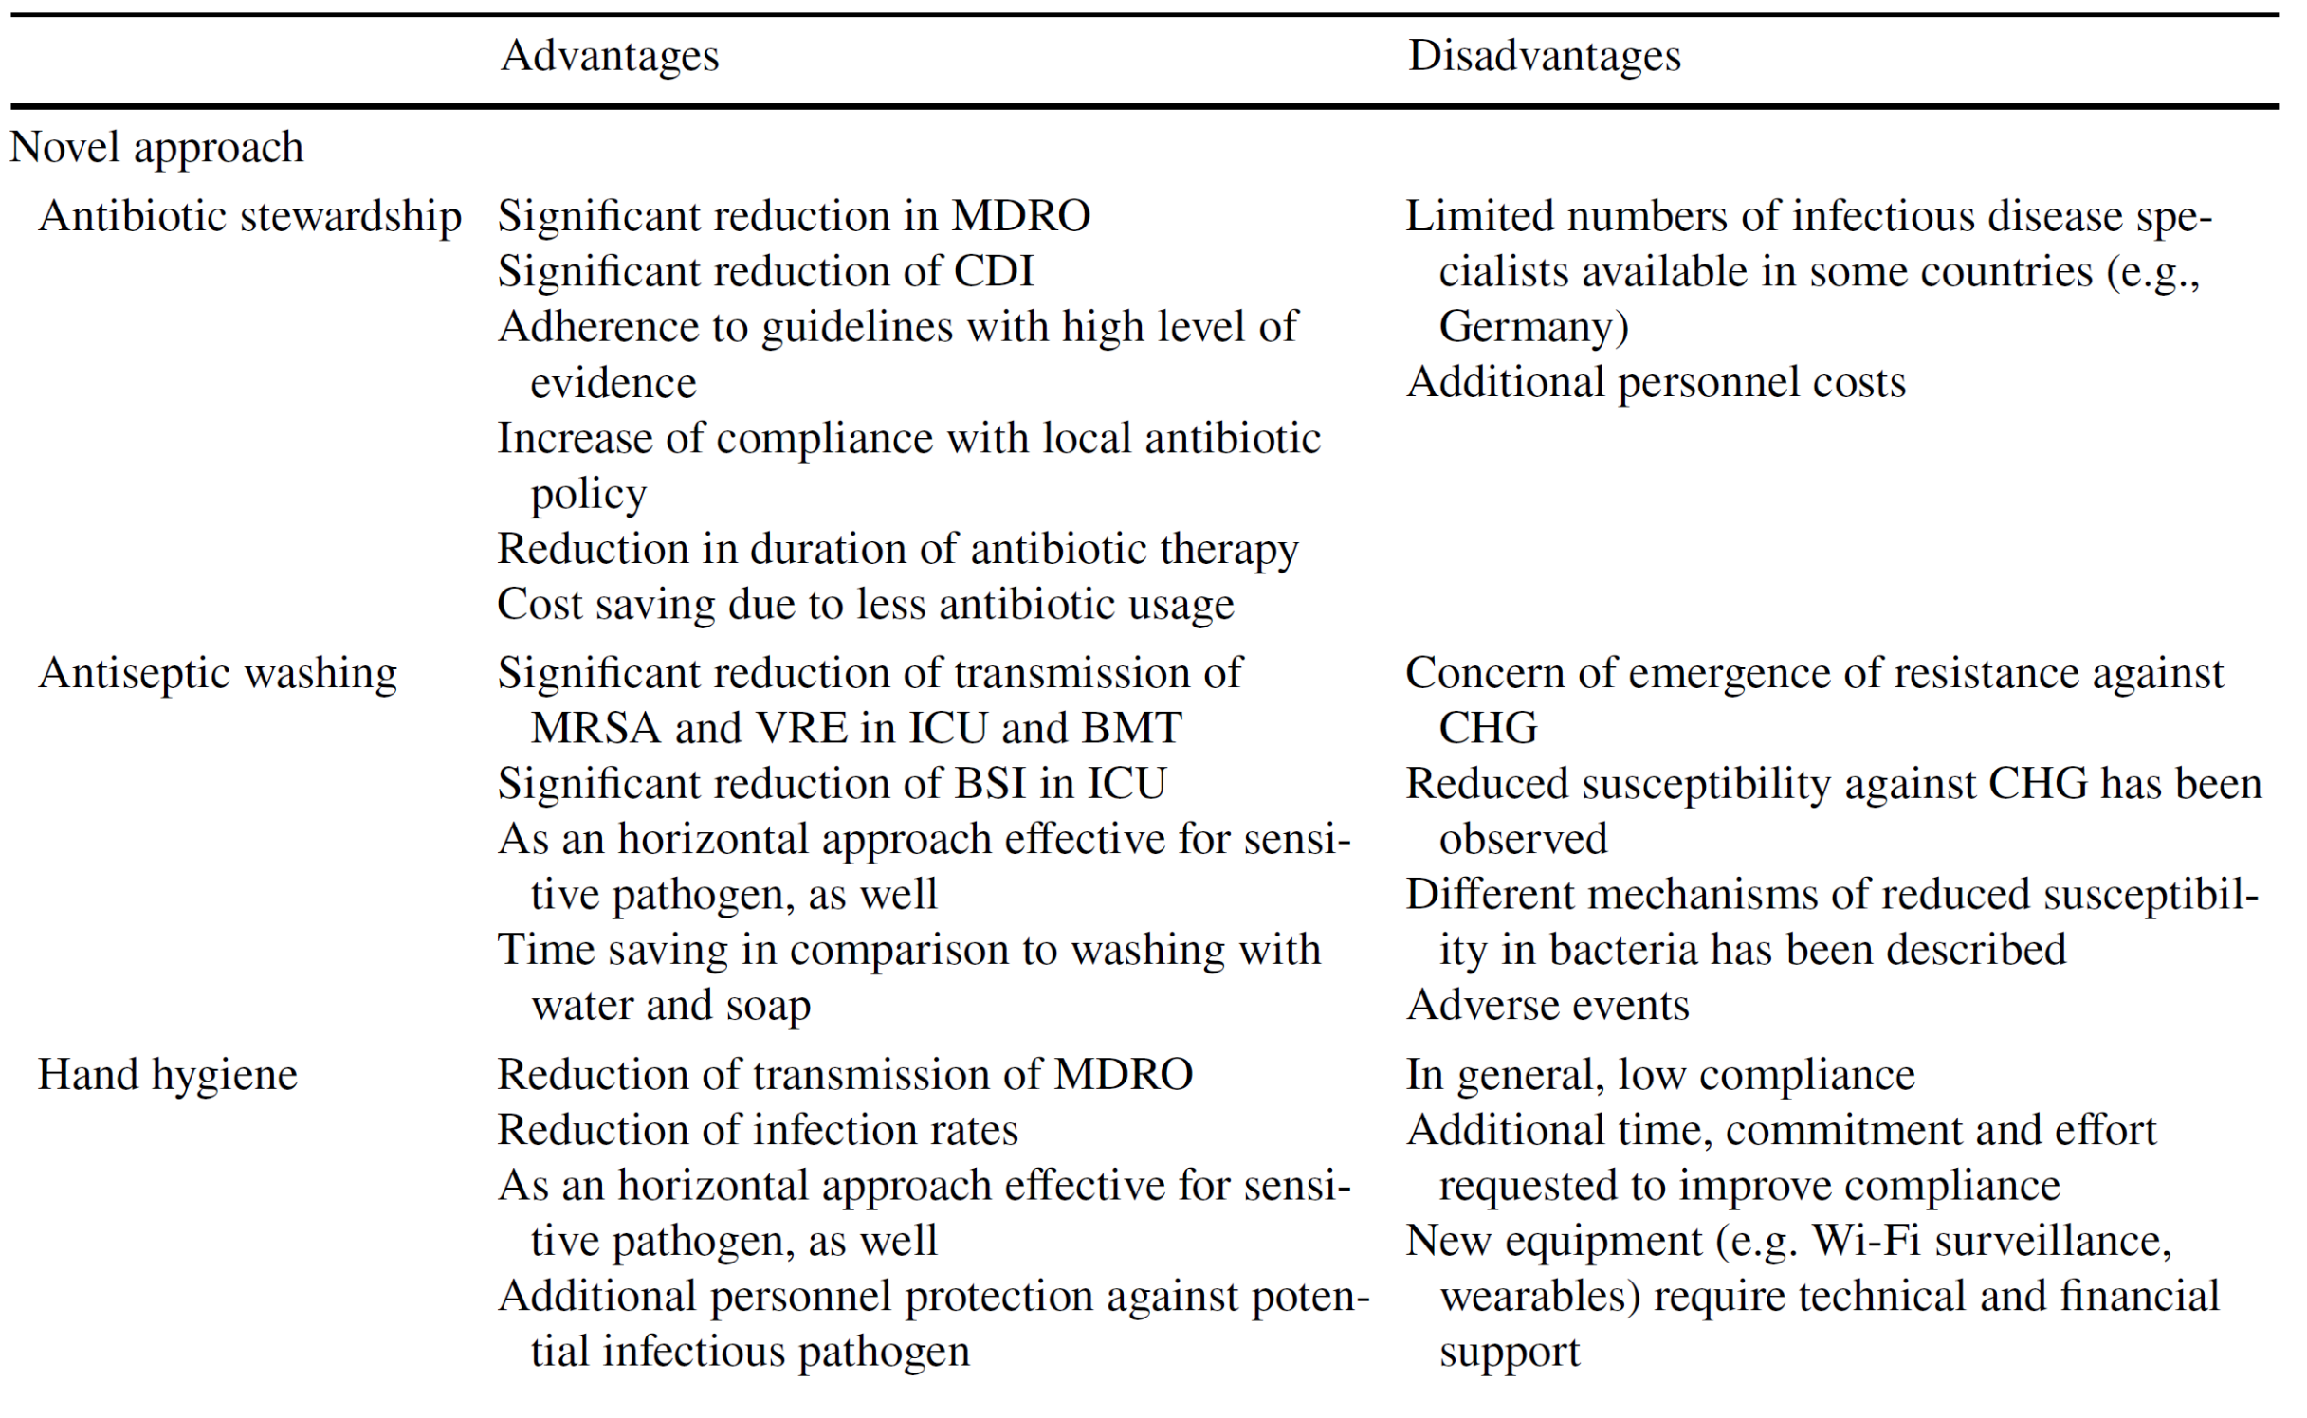
Lemmen SW, Lewalter K. Infection. 2018 May

Slide 51
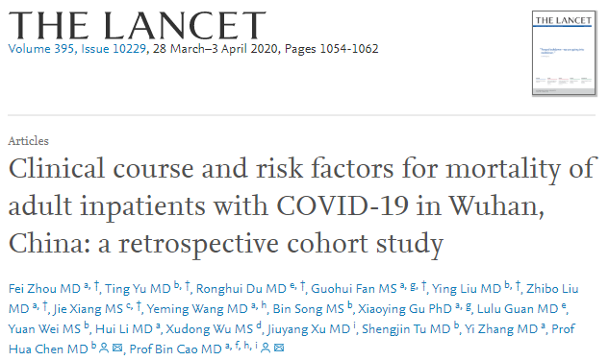

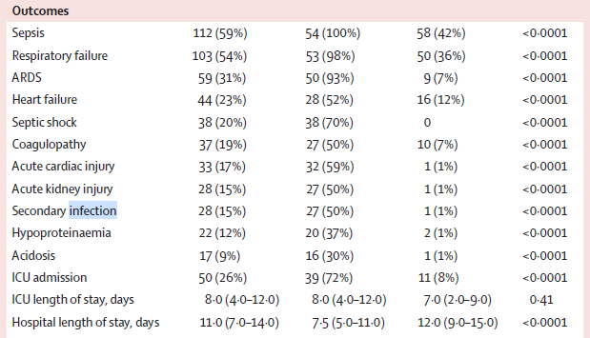
Significant Deaths d/t Sepsis & Superinfection
15% developed secondary inf.
> 50% of patients developed sepsis
Sepsis developed at a median of 9 days
Followed by ARDS @ 12 days
Secondary infection @17 days

Slide 52
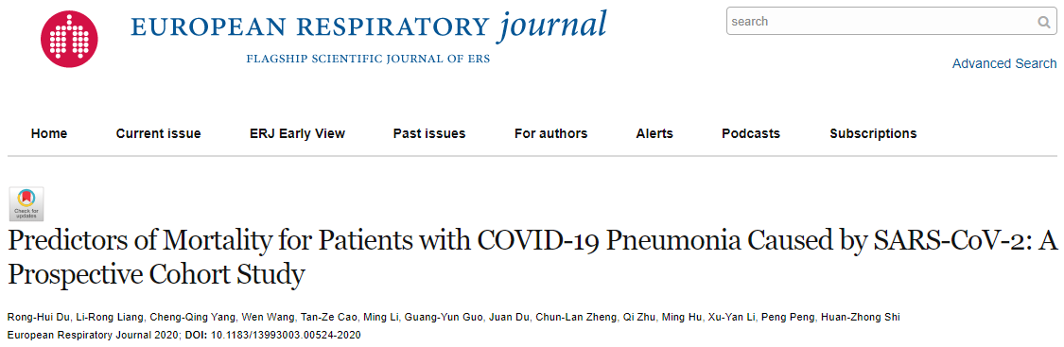
Secondary bacterial infection was suggested by high CRP and procalcitonin
The deceased had more WBC and neutrophils than the survivors.
Secondary bacterial infection were seen at late stage of disease (10/21) deceased patients
Organisms included klebsiella pneumoniae, staphylococcus, acinetobacter baumannii, and escherichia coli, etc.

Slide 53
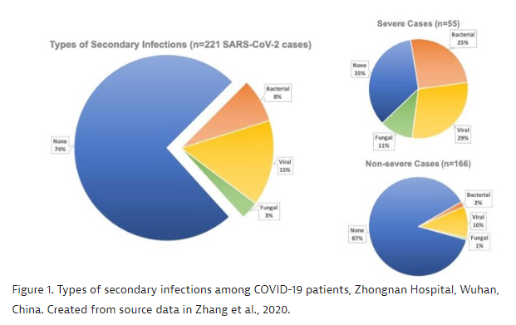
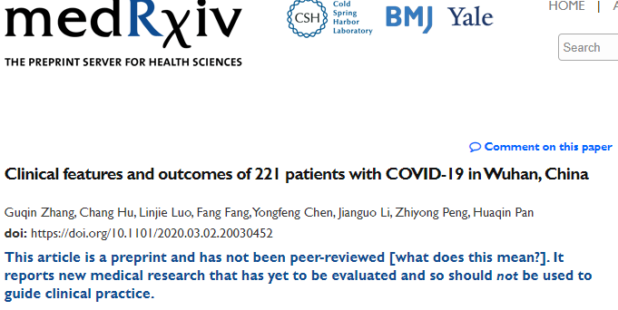
221 patients with SARS-CoV-2
Viral (57.9%) , Bacterial (29.8%) & Fungal (12.3%)

Slide 54
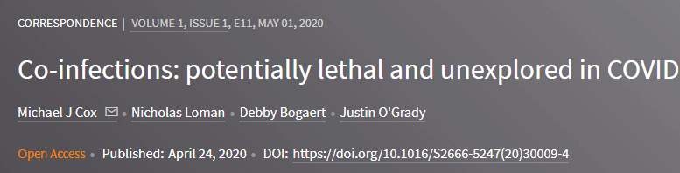

Slide 55
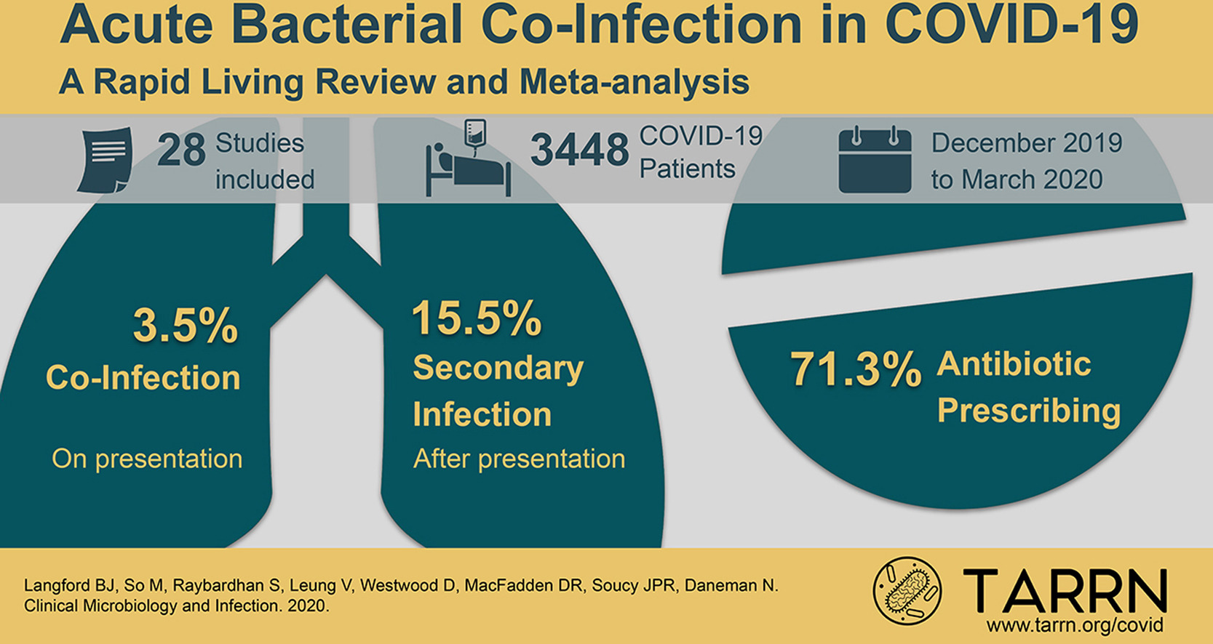
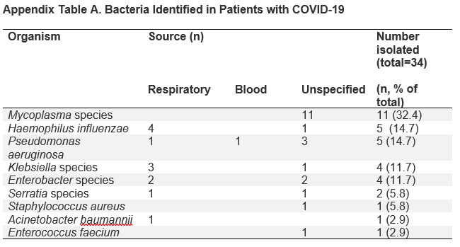
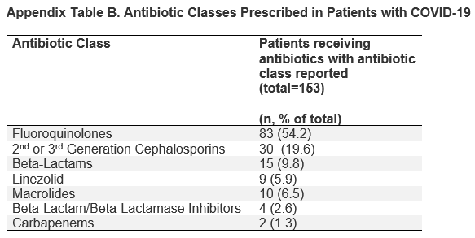
Fluoroquinolones and third-generation cephalosporins

Slide 56
The 2016 Indian infectious disease treatment guidelines recommend the glycopeptides vancomycin and teicoplanin as drugs of first choice for MRSA, linezolid for MRSA-induced SSTIs, and daptomycin for complicated SSTIs and bacteremia due to MRSA
VAP: Since vancomycin's ELF level is 1/6th that of serum and teicoplanin's ELF level is 1/3rd that of serum, teicoplanin may be preferable over vancomycin in VAP.
At equivalent concentrations, the postantibiotic effect of teicoplanin exceeds that of vancomycin for MRSA and E. faecalis
Despite the fact that linezolid has demonstrated fair efficacy in treatment of MRSA. In VAP, it is preferably avoided in the Indian setting owing to its importance as a crucial drug for multi drug resistant/extensively drug resistant tuberculosis
Ref: Singhal T et al., Treatment of MRSA infections in India:Clinical insights from a Delphi analysis, Indian Journal of Medical Microbiology,

Slide 57
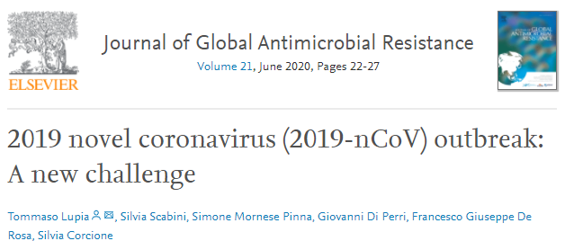
Covid 19-MRSA
Giving the number of common points between 2019-nCoV and previous coronavirus infection, anti-MRSA empirical treatment needs to be considered also with 2019-nCoV to reduce the risk of superinfection.
Assessing the risk of MRSA and other difficult-to-treat bacterial superinfections such as Pseudomonas aeruginosa and multidrug-resistant Gram-negative bacilli colonisation, according to cardiovascular co-morbidities, lung abnormalities or systemic diseases, the severity of pneumonia and the risks of adverse events or drug-related toxicity are crucial points for all suspected cases of 2019-nCoV.

Slide 58
Future ???
Vancomycin is no more the undisputed choice of antibiotic for MRSA infections.
A novel genomics-driven approach to drug development is being explored.
Molecules that target fatty acid synthesis such as vinaxanthone (interestingly, derived from Penicillium), which is an inhibitor of FabI, has been recently described as a selective inhibitor of S. aureus.
Similarly, molecules that target bacterial RNA polymerases, enzymes in the adenosine triphosphate pathway, teichoic acid synthesis, lipid II synthesis and bacterial protein synthesis are potential options for the future
A.M. Bal et al. / Journal of Global Antimicrobial Resistance 10 (2017) 295–303

Slide 59
Future ???
Tea-tree oil in for nasal application for eradication of carriage of MRSA.
Antiseptic-coated endotracheal tubes for prevention of ventilator-acquired MRSA
Hydrogenperoxide-based gas to decontaminate the environment
Air filtration units
Phage therapy
The ‘XF’ compounds—said to bind to the surface of bacteria and produce lethal amounts of oxygenated radicals on exposure to light energy.
S W B Newsom, J R Soc Med. 2004 Nov; 97(11): 509–510

Slide 60
Summary
The classical approach composed of screening, isolation and eradication has many limitations
  Lack of standardization of the screening methods
  Risk of medical errors for patients in isolation
  Failure to eradicate resistant bacteria
  Concrete evidence that this current infection control approach actually prevents transmission is still lacking

Slide 61
Summary
A novel approach with the training of infectious diseases specialists can reduce the usage of antimicrobials, thereby significantly decreasing the emergence of new MDROs.
Increased hand hygiene compliance not only reduces transmission of MDROs, but also that of sensitive organisms causing the majority of nosocomial infections.
Instruments, such as continuing education, bed-side observation, and the use of new tools, e.g. electronic wearables and Wi-Fi-equipped dispensers, are all options that can also improve the current low hand hygiene compliance levels.
Daily antiseptic body washes were observed to reduce the transmission of MDROs, especially those deriving from the body surface-like MRSA and VRE in specific settings.
  Antiseptic body washes were seen to have similar effects on reducing transmission rates as screening and isolation measures.
Approach to MRSA infection is likely to be tailored to individual clinical situations.

Slide 62
Key Questions
Is MRSA rising in India?
Experience with MRSA as a superinfection in COVID patients OR do you foresee?
In case of VAP would you consider an antibiotic, based on the ELF levels?
Since linezolid is a potential option in MDR TB, do you see an awareness in this regard?
Management of VRE-BSI
Approach to C. difficile-associated infection

Slide 63

THANK YOU

