Slide 1

DEVICE-ASSOCIATED
INFECTIONS (DAIs)
Dr Rahul S Kamble, MBBS, MD Microbiology
Diploma Infectious Diseases (UNSW, Australia)
Infection Control course (Harvard Medical School, USA)
International Clinical Tropical Medicine course
(CMC Vellore|Haukeland university|McGill university)
International Vaccinology course (CMC Vellore)
Six Sigma Black Belt (Govt of India certified)
Auditor: JCI|NABH|NABL|CSSD|RBNQA|Texila university
PGDBA|PGDHM|PGDCR|PGDMR|PGDOM|
PGDMLS|PGDIM|PGDHI|PGDBI|PGDHA|CCDHHO
Consultant Clinical Microbiologist & Infectious Diseases
Project Lead - Antimicrobial Stewardship

Slide 2
HEALTHCARE-ASSOCIATED INFECTIONS (HAIs)
Healthcare-associated infections (HAIs) – Is an infection occurring in a patient during the process of care in a hospital or other health care facility which was not present or incubating at the time of admission.
HAIs may be caused by infectious agents from endogenous or exogenous sources.
Endogenous sources are body sites, such as the skin, nose, mouth, gastrointestinal (GI) tract or vagina that are normally inhabited by microorganisms.
Exogenous sources are those external to the patient, such as patient care personnel, visitors, patient care equipment, medical devices or the health care environment.

Slide 3
1ST PRINCIPLE OF INFECTION PREVENTION
at least 35-50% of all healthcare-associated infections are associated with only 5 patient care practices:
Use and care of urinary catheters
Use and care of vascular access lines
Therapy and support of pulmonary functions
Surveillance of surgical procedures
Hand hygiene and standard precautions

Slide 4
Healthcare-Associated Urinary Tract Infection
Urinary tract infection (UTI) causes ~ 40% of hospital-acquired infections
Most infections due to urinary catheters
25% of inpatients are catheterized
Leads to increased morbidity and costs

Slide 5
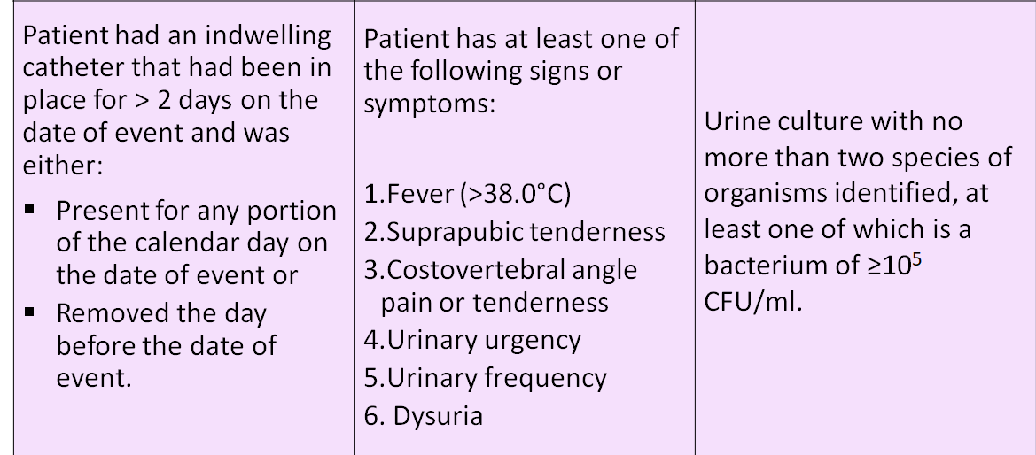
CAUTI Criterion

Slide 6
Prevention of Catheter-Associated Urinary Tract Infection
(CAUTI)
Avoid unnecessary catheterization
Two main principles
Limit the duration of catheterization

Slide 7
Indications for the use of indwelling urethral catheters
Indications
  Perioperative use for selected surgical procedures
  Urine output monitoring in critically ill patients
  Management of acute urinary retention and urinary obstruction
  Assistance in pressure ulcer healing for incontinent residents
  As an exception, at patient request to improve comfort
Urinary incontinence is not an accepted indication for urinary catheterization
  21 to 50 percent of urinary catheters not indicated
Lo et al. (2008) Infect Control Hosp Epidemiol Suppl 1:S41-50

Slide 8
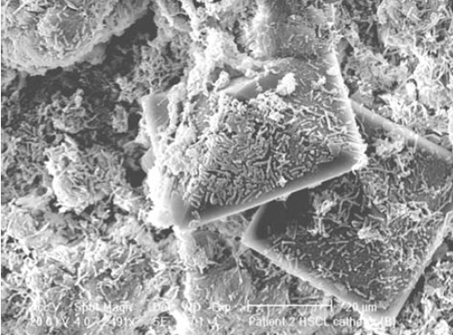
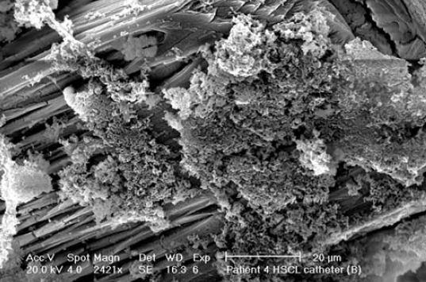
Is one catheter better than another?
No significant difference between latex and silicone catheters
What about coated / impregnated catheters?
The concept: prevention of biofilm formation
EM pictures of biofilms
on silver coated catheters
Morgan et al. (2009) Urol Res 37:89–93.

Slide 9
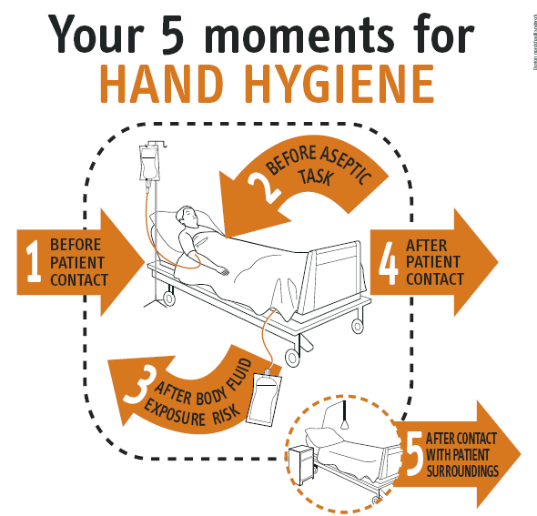

Catheter insertion and maintenance
Practice hand hygiene (A-III)
  before insertion of the catheter
  before and after any manipulation of the catheter site
http://www.who.int/gpsc/tools/en/

Slide 10
Catheter insertion and maintenance
Insert
Insert catheters by use of aseptic technique and sterile equipment (A-III)
Cleanse
Cleanse the meatal area with antiseptic solutions is unnecessary (A-I)
routine hygiene is appropriate
Secure
Properly secure indwelling catheters after insertion to prevent movement and urethral traction (A-III)
Maintain
Maintain a sterile, continuously closed drainage system (A-I)
Do not disconnect
Do not disconnect the catheter and drainage tube unless the catheter must be irrigated (A-I)
Lo et al. (2008) Infect Control Hosp Epidemiol Suppl 1:S41-50

Slide 11
Catheter insertion and maintenance
Maintain
Maintain unobstructed urine ﬂow (A-II)
Empty
Empty the collecting bag regularly, using a separate col- lecting container for each patient, and avoid allowing the draining spigot to touch the collecting container (A-II)
Keep
Keep the collecting bag below the level of the bladder at all times (A-III)
Do
Do not routinely use silver-coated or other antibacterial catheters (A-I)
Do not screen
Do not screen for asymptomatic bacteruria in catheterized patients (A-II)
Do not treat
Do not treat asymptomatic bacteruria in catheterized patients except before invasive urologic procedures (A-I)
Lo et al. (2008) Infect Control Hosp Epidemiol Suppl 1:S41-50

Slide 12

What you should not do to prevent CAUTI
Do not use (avoid) catheter irrigation (A-I)
Do not use systemic antimicrobials routinely as prophylaxis (A-II)
Do not change catheters routinely (A-III)
Lo et al. (2008) Infect Control Hosp Epidemiol Suppl 1:S41-50

Slide 13

1st principle of infection prevention
at least 35-50% of all healthcare-associated infections are associated with only 5 patient care practices:
Use and care of urinary catheters
Use and care of vascular access lines
Therapy and support of pulmonary functions
Experience with surgical procedures
Hand hygiene and standard precautions

Slide 14

Central Line Associated
Blood Stream Infection (CLABSI)
A laboratory-confirmed primary bloodstream infection in a patient where the central line was in place for > 2 calendar days (48 hours) on the date of the event, with day of device placement being Day 1.

Slide 15
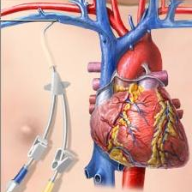
A central line is
  An intravascular catheter that terminates at or close to the heart or in one of the great vessels which is used for infusion, withdrawal of blood, or hemodynamic monitoring
Examples of Great Vessels include:
  Aorta
  Pulmonary artery
  Superior vena cava
  Inferior vena cava
  Brachiocephalic veins
  Internal jugular veins
  Subclavian veins
  External iliac veins
  Common iliac veins
  Femoral veins
  In neonates, the umbilical artery/vein
15
Notes:
[Speaker, highlight content of slide]

Slide 16
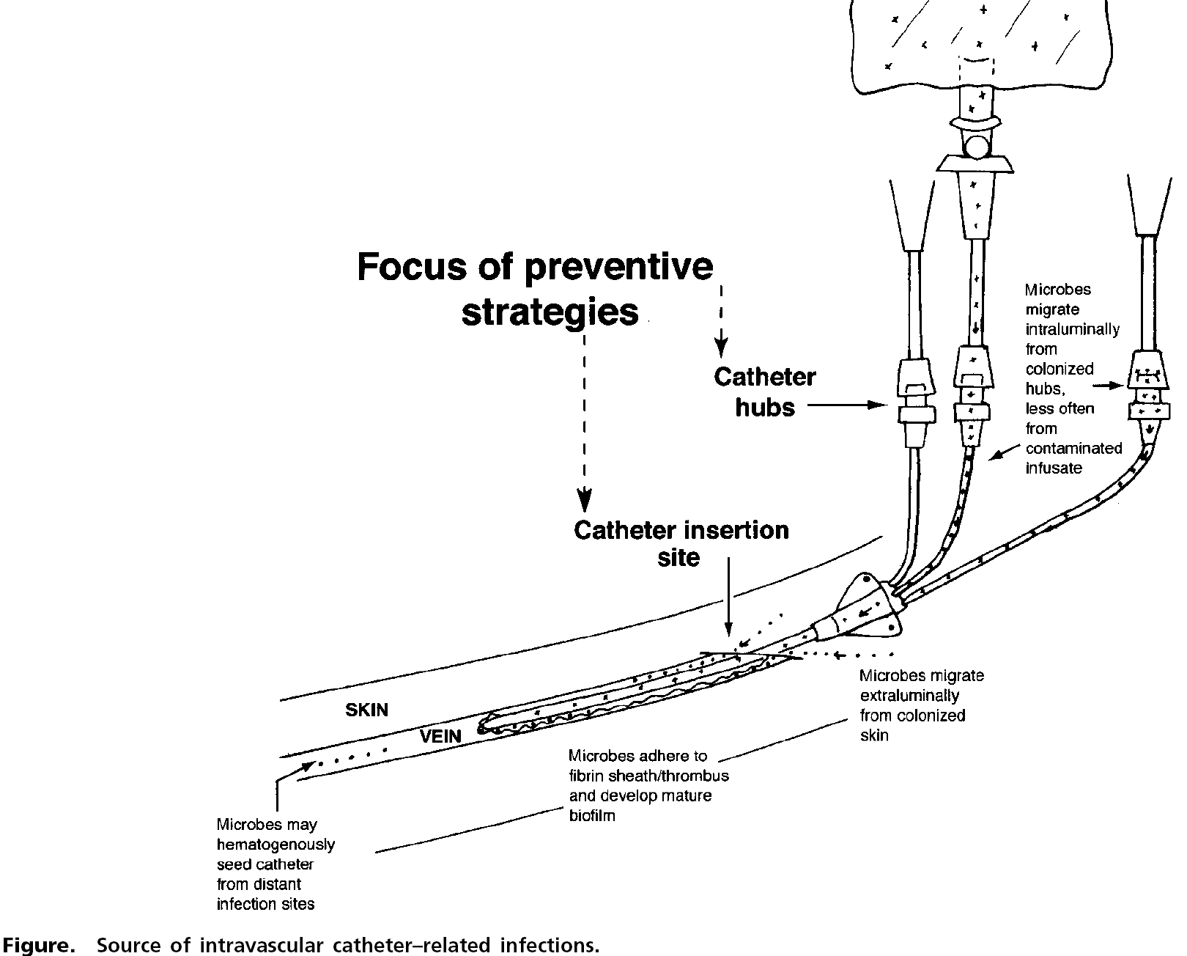
Sources of the catheter-associated bloodstream infection
Intraluminal from tubes and hubs
Hematogenous from distant sites
Extraluminal from skin
Skin
Vein

Slide 17
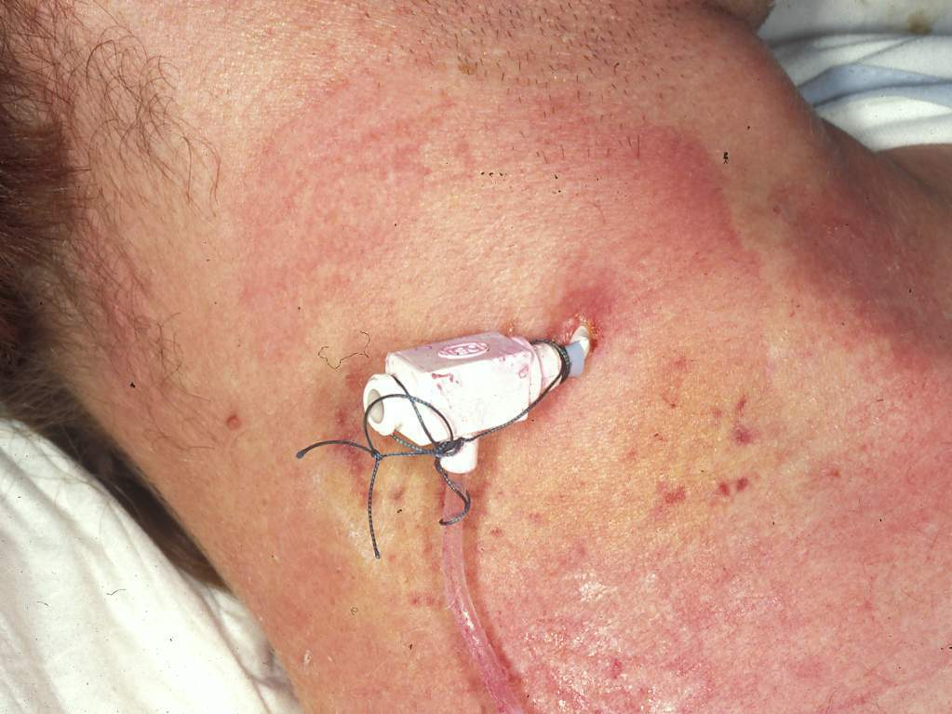
Prevention of vascular
access line infection
in intensive care

Slide 18
Prevention of vascular access line infection Medical intensive care unit
Incidence density
episodes/1’000 patient-days
12
11.3
9.2
8.2
3.1
10
reduction
1999
-67% primary BSI%
-68% clinical sepsis
-63% microbiologically doc. BSI
-64% insertion site infection -74%
8
6
3.8*
3.3*
2.6*
1.2*
4
2
0
1996
1997
1999
Eggimann et al. Lancet 2000; 355:1864
* P < 0.05

Slide 19
Multimodal intervention strategies to reduce catheter-associated bloodstream infections:
Hand hygiene
Maximal sterile barrier precaution at insertion
Skin antisepsis with alcohol-based chlorhexidine-containing products
Subclavian access as the preferred insertion site
Daily review of line necessity
Standardized catheter care using a non-touch technique
Respecting the recommendations for dressing change
Eggimann P. Lancet 2000; 35: 290
Pronovost P. N Engl J Med 2006; 355: 26
Zingg W. Crit Care Med 2009; 37: 2167
Notes:
19

Slide 20
Could we do better ?
Chlorhexidine gluconate-impregnated sponge
Notes:
20

Slide 21
Chlorhexidine-gluconate impregnated dressings decreased major catheter-related infections:
1.40 per 1000 catheter-days
Control dressings
HR = 0.39;
p=0.03
Cumulative Risk
ChG
dressings
0.60 per 1000 catheter-days
Catheter-days
Timsit JF. JAMA 2009; 301: 1231
Notes:
21

Slide 22
Prevention of vascular
access line infection
A multimodal strategy

Slide 23

1st principle of infection prevention
At least 35-50% of all healthcare-associated infections are associated with only 5 patient care practices:
Use and care of urinary catheters
Use and care of vascular access lines
Therapy and support of pulmonary functions
Experience with surgical procedures
Hand hygiene and standard precautions

Slide 24

Ventilator-Associated Pneumonia (VAP)
This infection is with onset of 48-72 hours of hospitalization, development of a new or progressive infiltrate in CXR, fever, leukocytosis and purulent tracheobronchial secretions.
This infection was neither present nor incubating at the time of hospitalization.

Slide 25
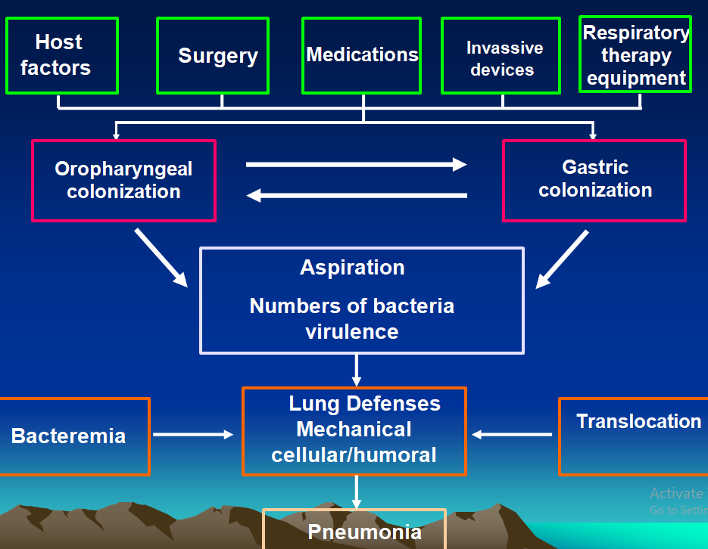

Slide 26
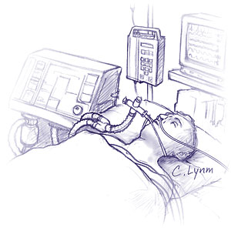
Risk factors for Ventilator-Associated Pneumonia (VAP)
Patient Related Factors
  Age
  Burns
  Coma
  Lung disease
  Immunosuppression
  Malnutrition
  Blunt trauma
Devices Related Factors
  Invasive ventilation
  Duration of invasive ventilation
  Reintubation
  Medication
  Prior antibiotic treatment
  Sedation

Slide 27
General precautions
Staff education, hand hygiene, isolation precautions (I)
Surveillance of infection and resistance with timely feedback (II)
Adequate staffing levels (II)
ATS Guidelines 2005

Slide 28
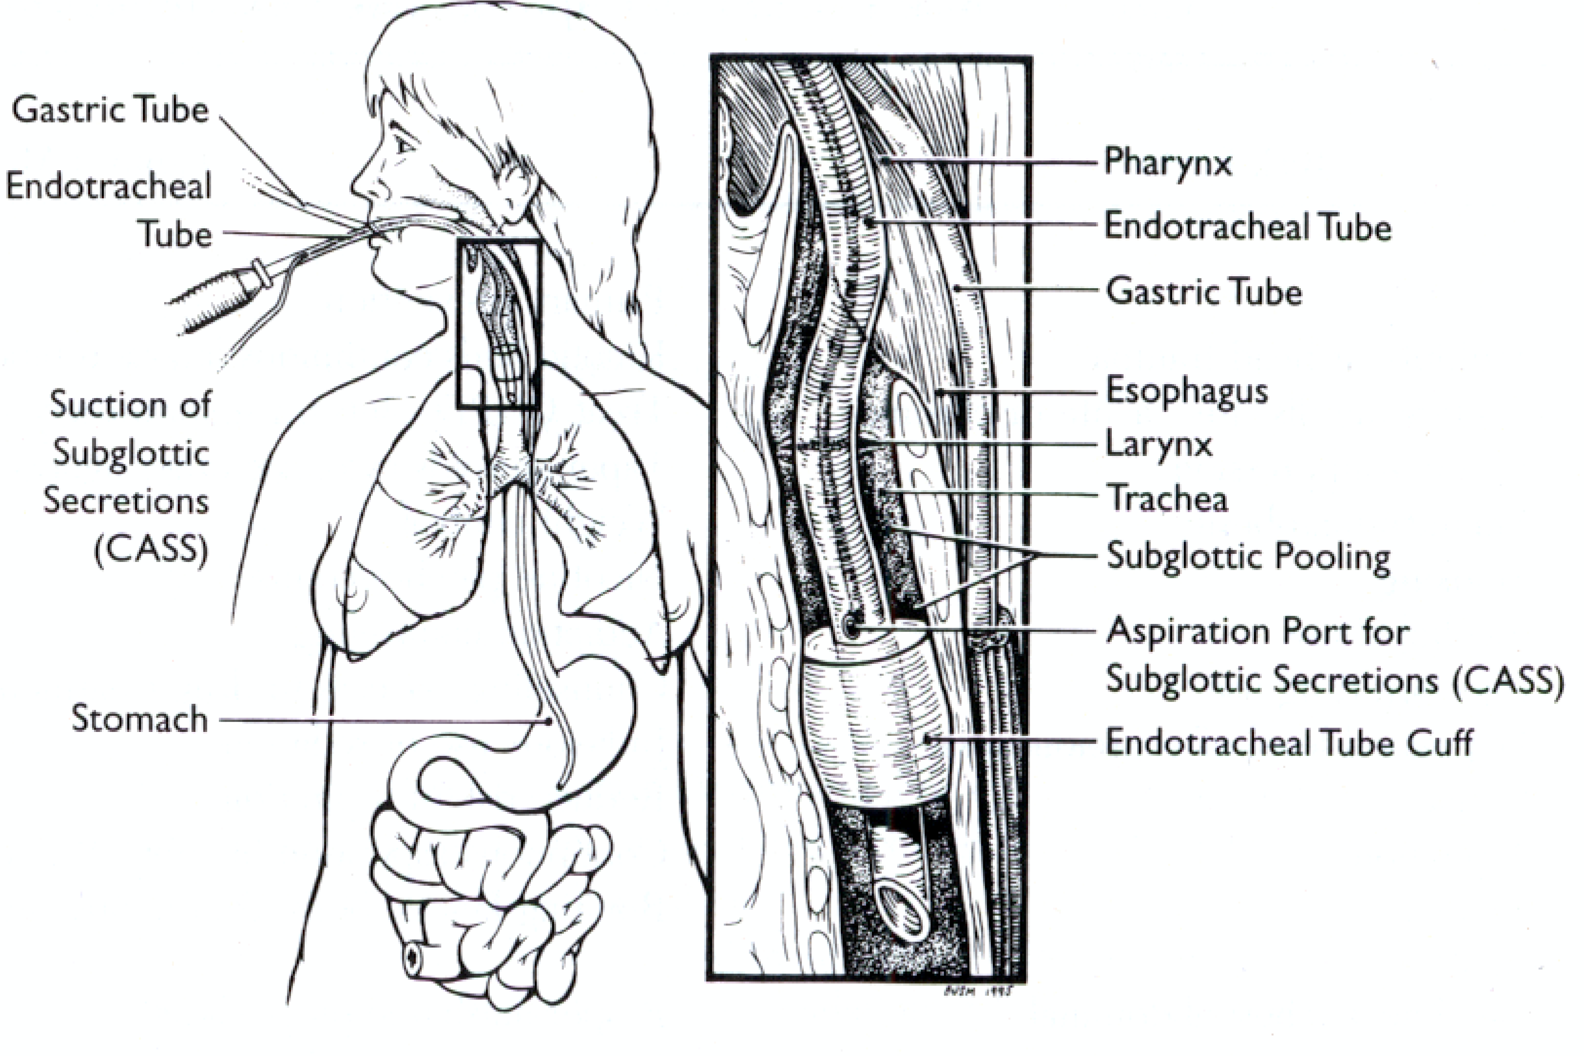

Slide 29
Intubation and ventilation
Avoid intubation and reintubation - I
Prefer non-invasive ventilation - I
Prefer orotracheal intubation & orogastric tubes - II
Continous subglottic aspiration - I
Cuff pressure > 20 cm H2O - II
Avoid entering of contaminate consendate into tube/nebulizer - II
Use sedation and weaning protocols to reduce duration – II
Use daily interruption of sedation and avoid paralytic agents - II
ATS Guidelines 2005

Slide 30
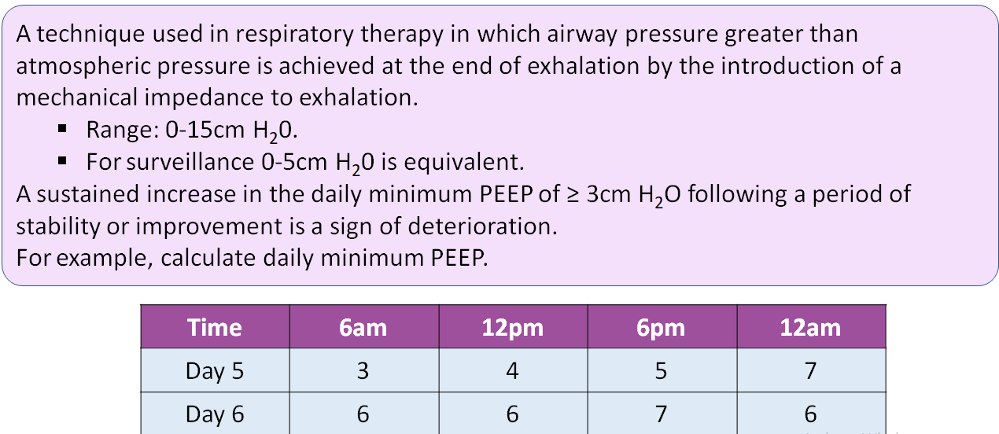
Positive End Expiratory Pressure (PEEP)

Slide 31
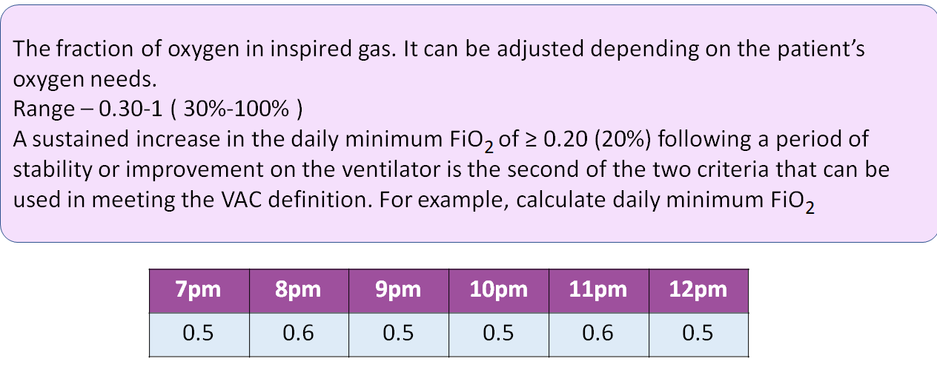
Fraction of Inspired Oxygen(FiO2)

Slide 32
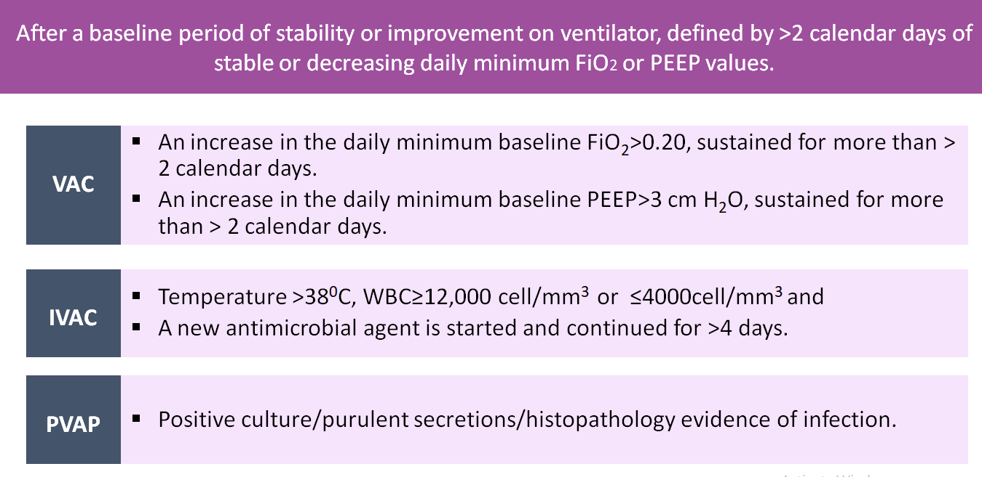

Slide 33

Systemic and enteral antibiotics
Selective decontamination of the digestive tract (SDD) reduces the incidence of VAP & helps to contain MDR outbreaks – I
But SDD not recommended for routine use – II
Prior systemic antibiotics helps to reduce VAP in selected patient groups but increases MDR – II
24-hour AB prophylaxis helps in one study but not for routine use - I
ATS Guidelines 2005

Slide 34
Stress bleeding, transfusion, hyperglycemia
Trend towards less VAP with sucralfate (vs H2 blockers) but increased gastric bleeding > individual choice - I
Prudent transfusion, leukocyte-depleted red blood cell transfusion - I
Intensive insulin therapy to keep glucose 80 - 110 mg/dl - I
Aspiration, body position
Semirecumbent position (30 - 45°) especially when receiving enteral feeding - I
Enteral nutrition is preferred over parenteral because of translocation risk - I
ATS Guidelines 2005

Slide 35
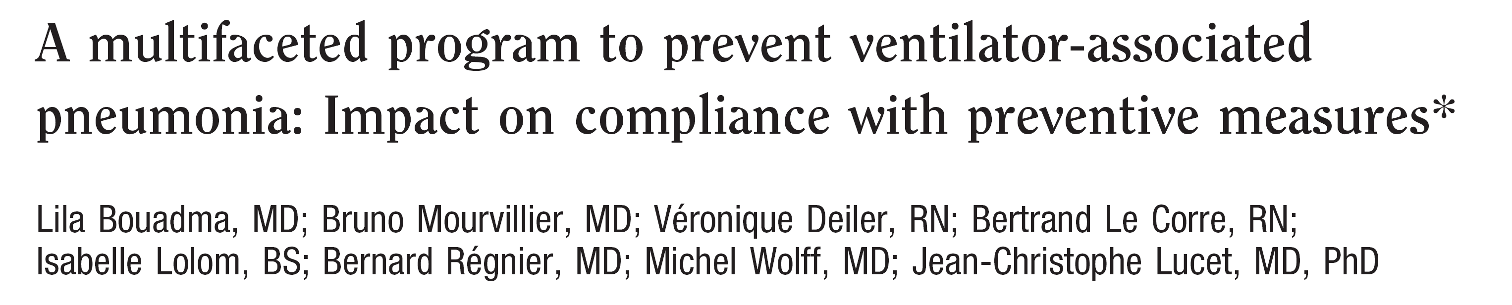
Crit Care Med 2010: volume 38 in Press
Adherence to hand hygiene
Adherence to glove and gown use
Backrest elevation maintenance
Correct tracheal-cuff maintenance
Orogastric tube use
Gastric overdistention avoidance
Good oral hygiene
Elimination of non-essential tracheal suction

Slide 36
VAP Prevention
Hand hygiene before and after patient contact, preferably using alcohol-based hand rubbing
Avoid endotracheal intubation if possible
Use of oral, rather than nasal, endotracheal tubes
Minimize the duration of mechanical ventilation
Promote tracheostomy when ventilation is needed for a longer term
Glove and gown use for endotracheal tube manipulation.

Slide 37
VAP Prevention (Don’t)
Avoid non-essential tracheal suction
Oral hygiene with chlorhexidine
Backrest elevation 30-45º
Maintain tracheal tube cuff pressures (>20) to prevent regurgitation from the stomach
Avoid gastric overdistension
Promote enteral feeding
Careful blood sugar control in patients with diabetes
SDD in selected cases

Slide 38

1st principle of infection prevention
at least 35-50% of all healthcare-associated infections are associated with only 5 patient care practices:
Use and care of urinary catheters
Use and care of vascular access lines
Therapy and support of pulmonary functions
Experience with surgical procedures
Hand hygiene and standard precautions

Slide 39
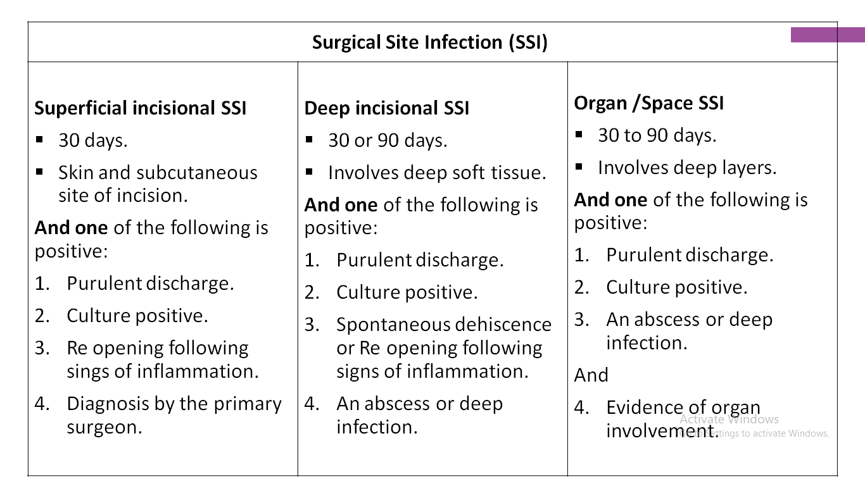
Surgical Site Infection (SSI)

Slide 40
Strategies to prevent SSI
Objectives
Reduce the inoculum of bacteria at the surgical site
Surgical Site Preparation
Antibiotic Prophylaxis Strategies
Optimize the microenvironment of the surgical site
Enhance the physiology of the host (host defenses)
In relation to risk factors, classified as
Patient-related (intrinsic)
Pre-operative
Operative

Slide 41
Patient-related factors
DIABETES (Recommendation -IDSA/SHEA)
  Preoperative
    Control serum blood glucose; reduce HbA1C levels to <7% before surgery if possible (A-II)
  Post-operative (cardiac surgery patients only)
    Maintain the postoperative blood glucose level at less than 200 mg/dL (A-I)
SMOKING
Rationale
  Nicotine delays wound healing
  Cigarette smoking = independent RF for SSI after cardiac surgery
Studies:- None
Recommendation
  Encourage smoking cessation within 30 days before procedure

Slide 42
Procedure-related risk factors
Hair removal technique
Preoperative infections
Surgical scrub
Skin preparation
Antimicrobial prophylaxis
Surgeon skill/technique
Asepsis
Operative time
Operating room characteristics

Slide 43

Antimicrobial prophylaxis
Recommendations (A-I)
  Administer within 1 hour of incision to maximize tissue concentration
    Once the incision is made, delivery to the wound is impaired
Notes:
Why not useful in post-operative: Systemically Administered Antibiotic does not penetrate the Established Fibrin Matrix in the Wound.¹

Slide 44
Antimicrobial prophylaxis
Duration of prophylaxis (A-I)
  Stop prophylaxis
    within 24 hours after the procedure
    within 48 hours after cardiac surgery
  To:
    Decrease selection of antibiotic resistance
    Contain costs
    Limit adverse events
Bratzler et al Arch Surg 2005, 140:174-82
Harbarth S et al. Circulation 2000;101:2916–2921

Slide 45
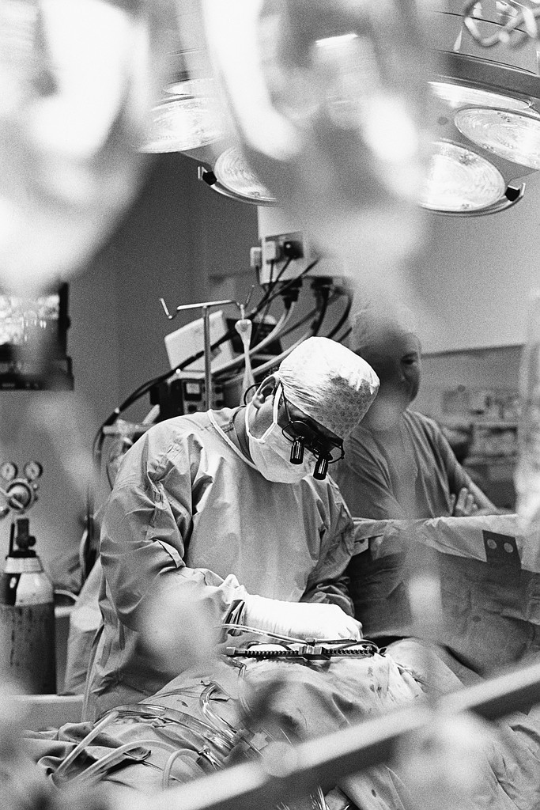
Surgeon Skill and Technique
Excellent surgical technique reduces the risk of SSI (A-III)
Includes
  Gentle traction and handling of tissues
  Effective hemostasis
  Removal of devitalized tissues
  Obliteration of dead spaces
  Irrigation of tissues with saline during long procedures
  Use of fine, non-absorbed monofilament suture material
  Wound closure without tension
  Adherence to principles of asepsis

Slide 46
7 “S” Bundle to Prevent SSI
SAFETY – is your OPERATING ROOM safe?
SCREEN – are you screening for risk factors and presence of MRSA & MSSA
SHOWERS – do you have your patients cleanse their body the night before and morning of surgery with CHLORHEXIDINE (CHG)?
SKIN PREP – are you prepping the skin with alcohol based antiseptics such as CHG?
SOLUTION - are you irrigating the tissues prior to closure to remove exogenous contaminants? Are you using CHG?
SUTURES – are you closing tissues with antimicrobial sutures?
SKIN CLOSURE – are you sealing the incision or covering it with an antimicrobial dressing to prevent exogenous contamination?

Slide 47
Preoperative recommendations to prevent SSIs
Surgical practices | WHO 2018 | CDC 2017 | NICE 2017
Antiseptic showers | Advise patients to shower with either a plain or antimicrobial soap before surgery | Advise patients to shower with soap before surgery | Advise patients to shower with soap before surgery
Hair removal | Should not be removed or, if absolutely necessary, use clipper. Strongly discourages the use of razors | - | Use electric clippers on day of surgery
Skin preparation solutions | Use alcohol-based antiseptic solutions based on CHG | Skin preparation in the operating room should be performed using an alcohol-based agent unless contraindicated. | Use either povidone iodine or CHG solution with or without alcohol
Antibiotic prophylaxis | Antimicrobial sealants should not be used after surgical site skin preparation | Administer preoperative antimicrobial agents only when indicated based on published clinical practice guidelines | Give it to patients before clean, clean-contaminated and contaminated surgery
Hand decontamination or hygiene | Either by scrubbing with a antimicrobial soap and water or using a suitable ABHR before donning sterile gloves | - | The operating team should remove hand jewellery, artificial nails and nail polish before operations
Nasal decontamination |  | - | Do not use nasal decontamination with topical antimicrobial agents
Mechanical bowel preparation | Should be used in combination with preoperative oral antibiotics patients undergoing elective colorectal surgery | - | Do not use it routinely to reduce the risk of surgical site infection
1. WHO Global Guidelines for the Prevention of Surgical Site Infection, 20168 2. Centers for Disease Control and Prevention Guideline for the Prevention of Surgical Site Infection, 2017.JAMA Surgery 3. Leaper et al., BMJ. 2008 Oct 28;337:a1924.

Slide 48
Intraoperative recommendations to prevent SSIs
Surgical practices | WHO 2018 | CDC 2017 | NICE 2017
Glycemic control | Suggest use of protocol for intensive blood glucose control | Blood glucose target levels <200 mg/dL | Do not give insulin routinely to patients who do not have diabetes
Wound irrigation | Insufficient evidences to recommend for or against saline irrigation Use aqueous PVP-I solution before closure Antibiotic irrigation before closure should not be used | Consider intraoperative irrigation of deep or subcutaneous tissues with aqueous iodophor solution | Do not use wound irrigation
Surgical hand gloves | Insufficient evidences | - | Double gloves recommended
Nasal decontamination | Recommend mupirocin 2% ointment | - | -
Maintaining patient homeostasis | Use warming devices | Maintain normothermia | Maintain patient temperature in line with ‘Inadvertent perioperative hypothermia
Gowns | Sterile, disposable, non-woven or sterile, reusable woven drapes and surgical gowns can be used during surgical operations | - | Operating team should wear sterile gowns during the operation
Hand decontamination |  | - | hands should be washed using either an alcoholic hand rub or an antiseptic surgical solution.
Wound dressing | Use wound protector devices | - | Cover surgical incisions with an appropriate interactive dressing at the end of the operation
1. WHO Global Guidelines for the Prevention of Surgical Site Infection, 20168 2. Centers for Disease Control and Prevention Guideline for the Prevention of Surgical Site Infection, 2017.JAMA Surgery 3. Leaper et al., BMJ. 2008 Oct 28;337:a1924.

Slide 49
Postoperative recommendations to prevent SSIs
 | WHO, 2016 | CDC, 2017 | NICE, 2017
Changing dressings |  |  | Use an aseptic non-touch technique for changing or removing surgical wound dressings
Topical antimicrobial agents for wound healing by primary intention | Perioperative antibiotic prophylaxis should not be continued in the presence of wound drain | Do not apply local antimicrobial agents to the surgical incision | Do not use topical antimicrobial agents for surgical wounds
Dressings for wound healing by secondary intention | Don’t use any type of advanced dressing over a standard dressing on primarily closed surgical wounds | - | Do not use Eusol and gauze, or moist cotton gauze or mercuric antiseptic solutions Use an appropriate interactive dressing Refer to a tissue viability nurse for advice on appropriate dressings
Debridement | - | - | Do not use Eusol and gauze, or dextranomer or enzymatic treatments
Specialist wound care services | - | - | a structured approach to care is required
1. WHO Global Guidelines for the Prevention of Surgical Site Infection, 2018 2. Centers for Disease Control and Prevention Guideline for the Prevention of Surgical Site Infection, 2017.JAMA Surgery 3. Leaper et al., BMJ. 2008 Oct 28;337:a1924.

Slide 50
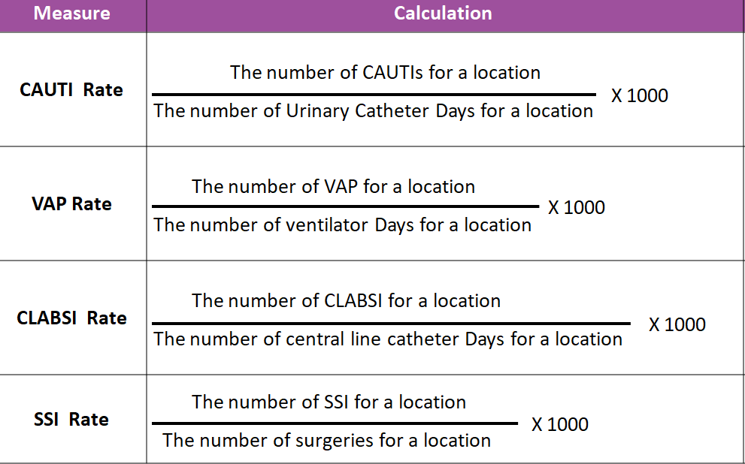

Slide 51
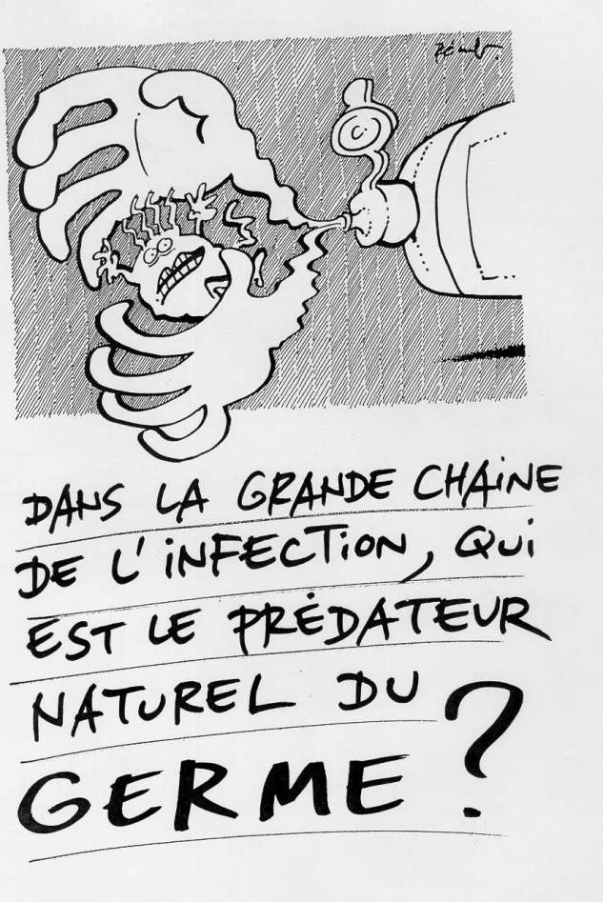
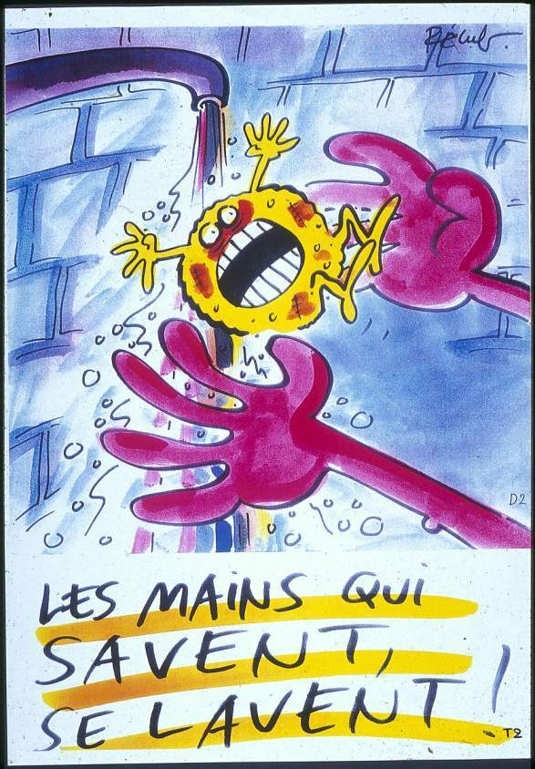
Handwashing …
an action of the past
(except when hands are visibly soiled)
Recognized
Explained
3. Act
Alcohol-based
hand rub
is standard of care

Slide 52
1. System change
Alcohol-based handrub at point of care
Access to safe, continuous water supply, soap and towels
The 5 core components of the WHO Multimodal Hand Hygiene Improvement Strategy
+
2. Training and Education
+
3. Observation and feedback
+
4. Reminders in the hospital
+
5. Hospital safety climate

Slide 53
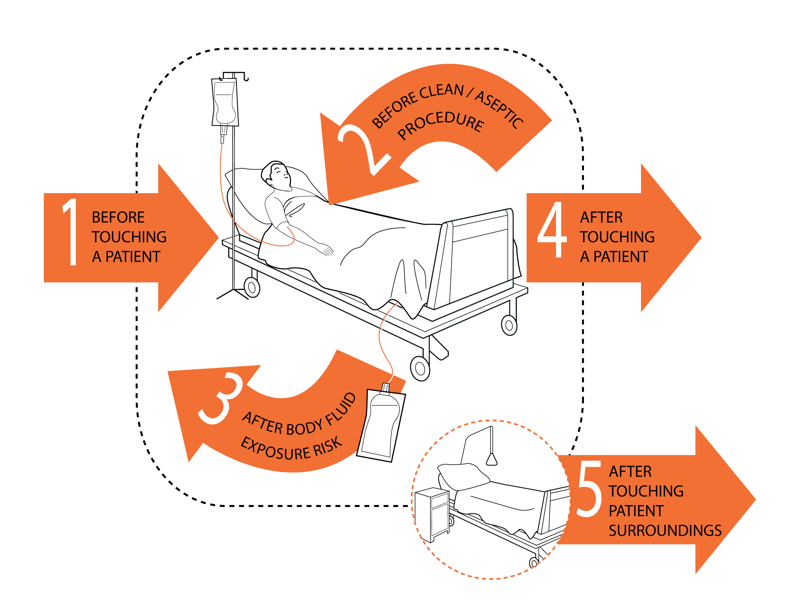
“My 5 Moments for Hand Hygiene”
Sax H, Allegranzi B, Uçkay I, Larson E, Boyce J, Pittet D. J Hosp Infect 2007;67:9-21

Slide 54
Infection Control and Quality Healthcare in the New Millenium
Multidisciplinary team approach
1847
1863
1958
1970
1980
1990
2000
Pittet D, Am J Infect Control 2005, 33:258

Slide 55
Infection Control and Quality Healthcare in the New Millenium
Where are we going ?
Healthcare system:
Hospitals
Ambulatory services
Nursing homes
Long-term care facilities
Home care delivery
systems
Patient safety
promotion
State/country
epidemiology
program
International
surveillance
systems
Financing
bodies
Pittet & Sax, Infectious Diseases. Cohen textbook (2nd ed.), chap.85, 2004

Slide 56
A multimodal strategy
System change
Education
Monitoring performance
+ feedback
Reminders
Safety culture

Slide 57

THANK YOU

