Slide 1
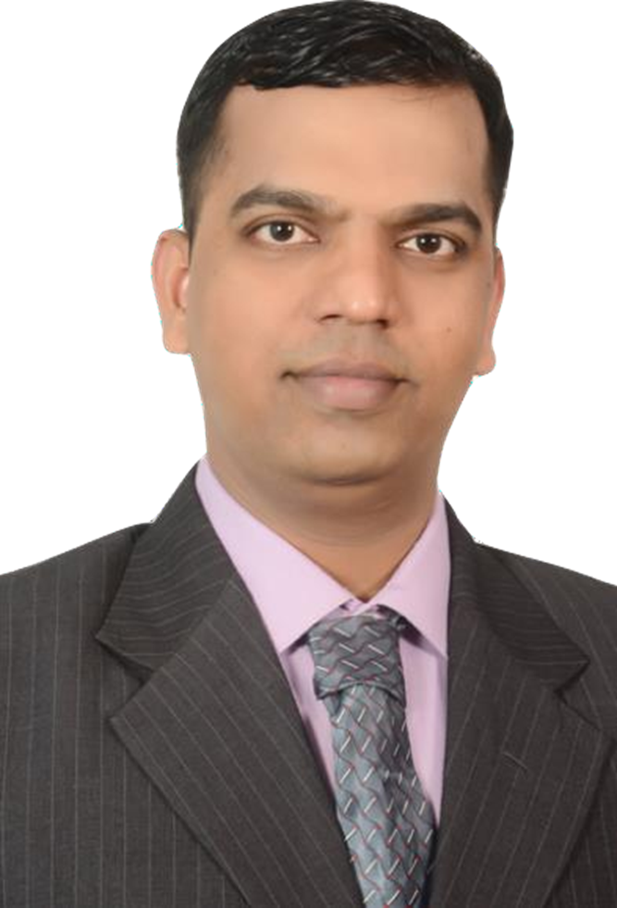
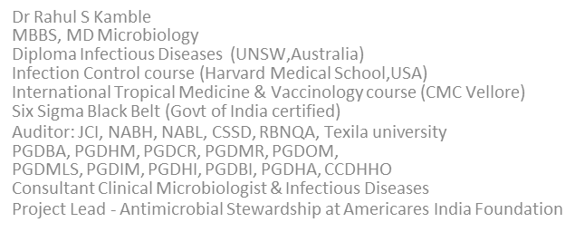
Blood and Body Fluid Spill Management

Slide 2
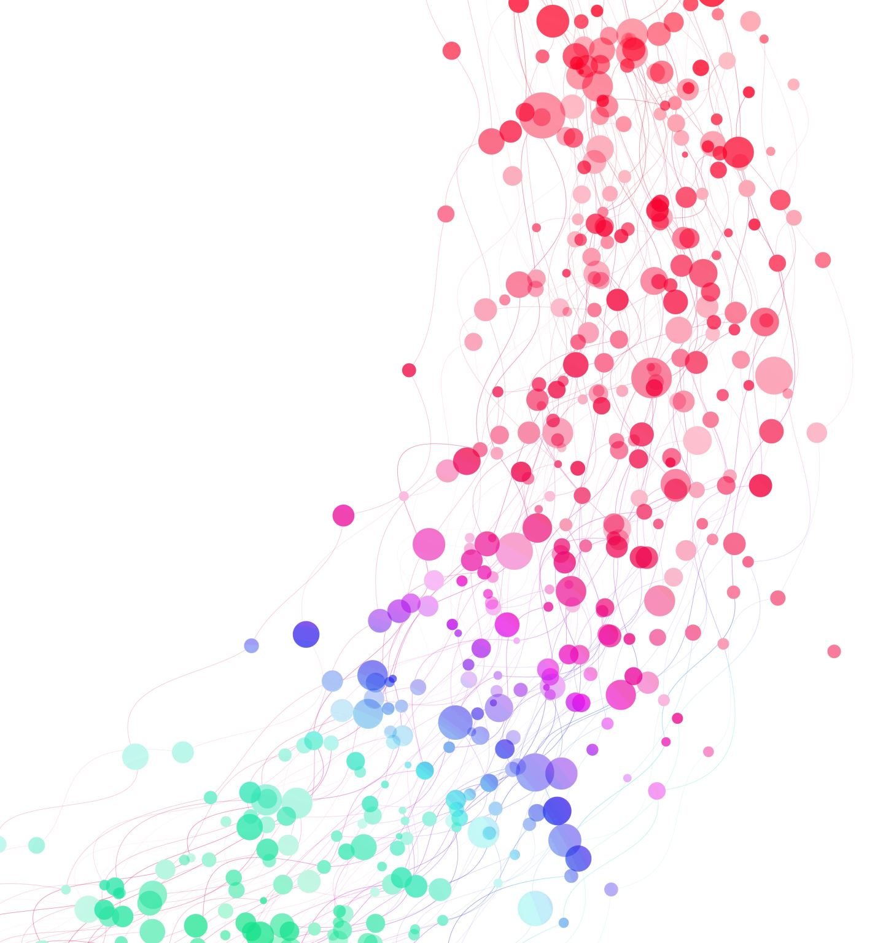
What are Body fluids?
Any fluid found in, produced by, or excreted from the human body which includes blood, urine, feces, saliva, tears, breast milk, cerebrospinal fluid(CSF),semen, vaginal fluid, amniotic fluid, pleural fluid, peritoneal fluid, bile, digestive juices, vomit and pus. In terms of standard infection control precautions practice ,body fluids are considered hazardous and should be dealt with immediately.

Slide 3
General Consideration
Treat all body fluids as if they were infected.
Follow standard precautions to ensure occupational safety.
Update training at least annually to maintain occupational safety

Slide 4
Fluids Capable of Transmitting Blood borne Pathogens

Slide 5
Risk of Transmission Following Exposure

Slide 6
Management of Blood/Body fluid exposure
Needle stick injury
Wash under running water.
Do not promote bleeding by squeezing the wound.
Mucous membrane or eye
Irrigate with water or normal saline.
Intact skin
Wash well with soap and water.
A risk assessment should be performed on the exposed person as soon as possible.

Slide 7
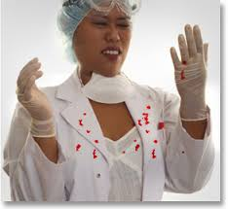
Blood and Body Fluid Exposure
Percutaneous –Needle stick injury (NSI)
Mucocutaneous-Splash

Slide 8
NEEDLE STICK INJURY POST-EXPOSURE PROTOCOL

Slide 9
Recommended Post exposure Prophylaxis HIV

Slide 10
Recommended Post exposure Prophylaxis(PEP)for HBV

Slide 11
Recommended Post exposure Prophylaxis(PEP)for HCV

Slide 12
POINTS TO BE REMEMBER HCW FOLLOW UP APPOINTMENTS
Follow up visits may include mental health or counseling appointments as well as medical management and required lab tests.
For the injured employee:
Dates and appointments must be set up with the ICN/Doctor or with designated clinician before the initial visit is completed.
Source patient unknown repeat HIV,HBsAg,abtiHCV,SGOT in 6 weeks 3 and 6 months.
Source patient HIV positive: repeat HIV in 6 weeks, 3and 6months (also monitor for-possible Hepatitis B and C exposure order HBsAg, SGOT, antiHCV in 6weeks, 3 and 6 months.
Health care worker who have received HIV chemoprophylaxis also need specific follow up for drug toxicity,CBC, LFT test should be repeated in two weeks and then again when the treatment course 28days is complete

Slide 13
BLOOD AND BODY FLUID SPILL MANAGEMENT
FOR SITE DECONTAMINATION OF SPILL OF BLOOD OR OTHER POTENTIALLY INFECTIOUS MATERIALS. Implement the following procedures Assess the spill-Major or minor Criteria for minor-less than 10ml –more than 10ml Place a caution board If sharps involved use forceps to pick it up and puncture resistant container
MINOR(>10ml) Take the spill kit and ware PPE Spread tissue paper or dry mop cloth over the spill Spray 1% freshly prepared sodium hypochlorite solution wait for 10-15 minutes Wipe from outer to inner area Dispose the contents in yellow bio hazard cover Label the bag containing the following information ward name& date Hand it over to house keeping House keeping personal instructed to clean with disinfectant and water Supervisor and infection control nurse to be informed Enter it the incident report form Spill log to be completed | MAJOR (10>ml) If spillage more than 10ml,inform housekeeping & infection control nurse. Housekeeping personnel instructed to bring spill kit and wear PPE Contain the spill be spreading dry mop cloth over it Pour 10% freshly prepared sodium hypochlorite over the cloth to prevent infection. Wait for 10-15 minutes Clean from outer to inner region Dispose the contents in yellow bio hazard cover Label the bag containing the following information ward name& date Hand it over to house keeping House keeping personal instructed to clean with disinfectant and water Supervisor and infection control nurse to be informed Enter it the incident report form Spill log to be completed

Slide 14
THANK YOU

